Slide 1









EHA 2026 Congress
June 11-14 2026, Stockholm, Sweden
Acute Myeloid Leukemia (AML)
& Myelodysplastic Syndromes (MDS)
The content is the sole responsibility of the coordinator, the authors, and the publication director, who ensure its objectivity.
Please note, this is a collection of communication summaries intended to provide information on the current state of research; therefore, the data presented may not be validated by French health authorities and should not be applied in practice.
This webinar
will be
hosted by
Ana ALFONSO PIEROLA
(Spain)
Lorenzo BRUNETTI
(Italy)
Sylvain GARCIAZ
(France)
Alexandre THEOCHARIDES
(Switzerland)
Andrius ZUCENKA
(Lithuania)
With the institutional support of
An AEI edition
Address: 52 rue de la Fédération 75015 Paris, France
Online Press Service Registration Number CPPAP: 1025 X 93190
CPPAP: Joint Commission for Publications and Press Agencies
Notes:
1

Slide 2
Disclosures
Ana ALFONSO PIEROLA
  Honoraria from lectures: BMS, Novartis, Abbvie, Jazz Pharma, Janssen, Astellas, Otsuka, Servier
  Participation in Ad Board meetings: BMS, Syros, Jazz Pharma, Otsuka, Ascentage Pharma, Janssen, Ipsen, Abbvie, Servier
  Consultant: Astellas, Jazz Pharma; Janssen, Servier, Ipsen
  Research Founding: Astra Zeneca
Lorenzo BRUNETTI
  Honoraria: Abbvie, Incyte, Servier, Jazz Pharmaceuticals, Biomea Fusion
Sylvain GARCIAZ
  Speaking engagement/advisory board: Servier, Abbvie, Imcheck Therapeutics
  Advisory board: Sanofi, BMS
Alexandre THEOCHARIDES
  Advisory: Astellas, Daiichi Sankyo, GSK, Novartis, Orpha Swiss, Servier, Takeda
  Speaker: Astellas, GSK, Servier
Andrius ZUCENKA
  Consulting fees: Abbvie, Astellas, Novartis, Pfizer, Jannsen, Servier, Molecular Partners
  Payment or honoraria for lectures, presentations, speakers bureau, publication writing or educational events : Abbvie, Astellas, Novartis, Pfizer, Jannsen, Servier
  Support for attending meetings and/or travel : Abbvie, Astellas, Novartis, Pfizer, Jannsen, Servier, Takeda
  Participation on a Data - Safety Monitoring Board or Advisory Board : Abbvie, Astellas, Novartis, Pfizer, Jannsen, Servier, Molecular Partners

Slide 3
Table of contents
Title | Abstract | Slides
Triplet Therapy (IVO + VEN + AZA) in IDH1-Mutated AML | S127 | 4–10
Ivosidenib-Based Triplet Therapy Compared with Doublet Regimens in IDH1-Mutated AML | PF513 | 11–14
ALIDHE: Ivosidenib + Azacitidine in Newly Diagnosed IDH1-Mutated AML | PS1599 | 15–19
Clinical Outcomes in IDH1-Mutated AML by Race-Ethnicity | PS1642 | 20–24
Gilteritinib vs Midostaurin in FLT3-Mutated AML | LB5005 | 25–29
Efficacy of Revumenib in AML Harboring NPM1-Mutated Co-mutations: Post-hoc Analysis of AUGMENT-101 | PF514 | 30–34
OPTI-AML: 28 vs 14 Days VEN + AZA in Newly Diagnosed AML | S126 | 35–40
LD-VENEX: Reduced-Duration VEN + AZA in de novo AML, Secondary AML and R/R AML | S129 | 41–45
IDH1 Testing and Frontline Treatment Patterns in AML | PF517 | 46–50
Frontline Treatment Intensity and Survival in IDH-Mutated AML | PS1645 | 51–53
Post-Transplant Revumenib in KMT2Ar, NPM1m, and NUP98r AML: AUGMENT-101 | PS1631 | 54–57
Revumenib Maintenance After Allogeneic SCT in AML | PS1629 | 58–62
Long-Term Follow-Up of Revumenib in Pediatric/YA KMT2A-r Acute Leukemia | PS508 | 63–67
Revumenib + Intensive Chemotherapy in Newly Diagnosed AML | PF489-1 | 68–71
Targeted Triplet Strategies in FLT3- and IDH1-Mutated AML | PF565 | 72–75
Ziftomenib + Intensive Chemotherapy: Long-Term Results of the KOMET-007 Study | S130 | 76–81
Ziftomenib Exposure–Response Analysis in NPM1m/KMT2Ar AML | PF537 | 82–83
Acquired MEN1 Resistance Mutations Identified During Menin-KMT2A Inhibition in a Phase 1 Enzomenib Trial | PS1527 | 84–88

Slide 4
Triplet Therapy (IVO + VEN + AZA) in IDH1-Mutated AML (1)
Key inclusion criteria
  Age ≥ 18 years
  IDH1 R132 mutant disease
  Relapsed/refractory AML, newly diagnosed (ND) AML, high-risk MDS and/or MPN
  ECOG PS ≤ 2 with adequate organ function
Key exclusion criteria
  Prior VEN or IVO
Enrollment sites
  Cleveland Clinic
  DFCI
  MDACC
  OHSU
Multicenter investigator-initiated study design
Phase Ib
Phase II
IVO + VEN 800 + AZA
Analysis after full enrollment of
the ND AML cohort at the RP2D
(n = 40)
DL4
Cont
X 14 days
X 7 days
IVO + VEN 400 + AZA
RP2D
IVO + VEN 400 + AZA
DL3
Cont
X 14 days
X 7 days
Cont
X 14 days
X 7 days
DL2
IVO + VEN 800
Primary objectives
Safety and tolerability
ORR = CR + CRh + Cri + MLFS + PR within
5 cycles
Secondary objectives
OS (treatment initiation to death)
DOR (best response to death, relapse, or last follow-up)
MRD negativity by flow cytometry
Cont
X 14 days
DL1
IVO + VEN 400
Cont
X 14 days
RP2D dosing (28 day cycle)
Ivosidenib (IVO) 500 mg PO continuously starting C1D15
Venetoclax (VEN) 400 mg PO on days 1-14
Azacitidine 75 mg/m² IV or SQ on days 1-7
EHA 2026, Marvin-Peek J, abstract S127
Notes:
“This slide summarizes the multicenter investigator-initiated study of triplet therapy with ivosidenib, venetoclax, and azacitidine in IDH1-mutated AML.
On the left are the key eligibility criteria: adults with IDH1 R132-mutated AML, including relapsed/refractory disease, newly diagnosed AML, high-risk MDS, or MPN, with ECOG performance status of 2 or less. Patients with prior venetoclax or ivosidenib were excluded. Enrollment sites were all in the US
The middle part of the slide shows the Phase Ib dose-escalation schema, evaluating different dose levels of IVO plus VEN, with AZA added at higher levels. The recommended Phase II dose was IVO 500 mg PO continuously starting at C1D15 plus VEN 400 14 days plus AZA.
On the right, Phase II evaluates this recommended dose after full enrollment of the newly diagnosed AML cohort, with 40 patients planned.
The primary objectives are safety, tolerability, and overall response rate, while secondary objectives include overall survival, duration of response, and MRD negativity by flow cytometry.”

Slide 5
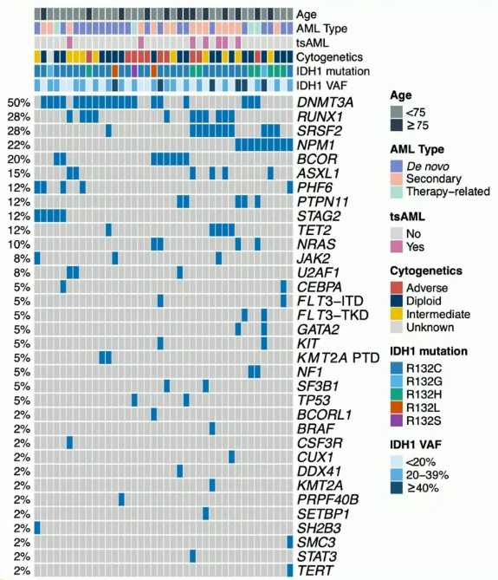
Triplet Therapy (IVO + VEN + AZA) in IDH1-Mutated AML (2)
Cohort characteristics
Variable | Newly Diagnosed AML (N=40)
Age | 72 (51- 80)
AML type De novo AML Secondary to AHD tsAML Therapy-related | 21 (53) 15 (38) 7 (18) 4 (10)
Treating institution Cleveland Clinic DFCI MDACC OHSU | 1 (3) 17 (43) 19 (48) 3 (8)
IDH1 VAF (%) | 24 (6-46)
ELN2022 Favorable Intermediate Adverse | 7 (18) 5 (13) 28 (70)
ELN2024 Favorable Intermediate Adverse | 33 (83) 5 (13) 2 (5)
EHA 2026, Marvin-Peek J, abstract S127
Notes:
The table on the left summarizes cohort characteristics for 40 newly diagnosed AML patients.
Key points:
Median age: 72 years (range 51–80)
AML types include de novo, secondary to antecedent of hematologic disease, tsAML, and therapy-related AML
Median IDH1 VAF: 24% (range 6–46%)
Risk classification was mostly Favorable per ELN2024
On the right side you see the main molecular patern including mainly DNMT3, RUNX1, SRSF2 and NPM1 mutations

Slide 6
Triplet Therapy (IVO + VEN + AZA) in IDH1-Mutated AML (3)
Treatment density per cycle
1
14
28
42
1
14
28
42
1
14
28
42
1
14
28
42
1
14
28
42
1
14
28
42
1
14
28
42
Dose modification with Azoles
AZA (75 mg/m²) | No dose modifications
VEN (400 mg) | Moderate CYP3Ai : 200 mg Strong CYP3Ai : 100 mg Posaconazole : 70 mg
IVO (500 mg) | No dose modifications Monitor for AEs Monitor azole levels if able
Cycle #
1
2
3
4
6
9
12
Cycle
length
35
34
36
35
35
35
35
AZA
7
7
7
7
5
5
5
VEN
14
14
14
14
11
7
7
IVO
20
33
35
35
35
35
35
EHA 2026, Marvin-Peek J, abstract S127
Notes:
The graph synthetize the treatment density per cycle for the triplet regimen.
It compares dosing over cycles from 1 to 12:
Cycle length stays around 34–36 days
AZA decreases from 7 days to 5 days by later cycles
VEN decreases from 14 days to 11, then 7 days
IVO remains largely consistent at 35 days after cycle 2
The table on the right summarizes dose modifications with azoles:
VEN (400 mg) doses were
Moderate CYP3A inhibitor: 200 mg
Strong CYP3A inhibitor: 100 mg
Posaconazole: 70 mg
IVO (500 mg): No dose modifications;

Slide 7
Triplet Therapy (IVO + VEN + AZA) in IDH1-Mutated AML (4)
Response and MRD outcomes with AZA + VEN + IVO
Patients without co-occuring « signaling »patway mutations have superior response
Best response
ORR = 95 %
MRD by flow
(limit of detection < 0,1 %)
5
NR
n = 2 (5 %)
MLFS
n = 1 (2,5 %)
Cri
n = 6 (15 %)
CRh
n = 7 (18 %)
CR
n = 24 (60 %)
p = 0,046
100 %
4
MRD+
n = 3 (9 %)
MRD-
n = 31 (91 %)
Best response
100 %
100 %
2
(13 %)
NR
5
(20 %)
MLFS
3
1(7 %)
CRi
75 %
Cycles of AZA + VEN + IVO
Cycles of AZA + VEN + IVO
2
(13 %)
CRh
2
75 %
75 %
2(8 %)
CR
% of patients
1
4
(27 %)
50 %
CRc
93 %
50 %
CRc
100 %
CRc
80 %
50 %
% of patients
% of patients
18
(72 %)
0
25 %
Best response
Time to best response
25 %
6
(40 %)
NR
25 %
MLFS
MRD negativity
CRi
No
0 %
CRh
0 %
Yes
0 %
ND AML
(n = 40)
CR
ND AML
(n = 34)
Absent
(n = 25)
Present
(n = 15)
Signaling mutation
EHA 2026, Marvin-Peek J, abstract S127
Notes:
Slide summarizes outcomes for triplet therapy (IVO + VEN + AZA) in IDH1-mutated AML.
Key points:
High overall response: ORR is 95% in newly diagnosed AML patients.
Best responses were achieved after 2 cycles in median
91% of patients MRD-negative by flow cytometry
The graph on the right shows the impact of co-occurring mutations. Patient without signaling pathway mutations showed better responses.

Slide 8
Triplet Therapy (IVO + VEN + AZA) in IDH1-Mutated AML (5)
Survival outcomes
with AZA + VEN + IVO
Survival outcomes
in responding patients by allogenic HSCT
Overall survival (OS)
Duration of remission
(DOR)
Cumulative incidence
of relapse (CIR)
Overall survival (OS)
Duration of remission
(DOR)
Cumulative incidence
of relapse (CIR)
100
100
75
75
p = 0,09
50
50
25
25
p = 0,70
p = 0,93
0
0
0
12
24
36
48
60
0
12
24
36
48
60
0
12
24
36
48
60
0
12
24
36
48
60
0
12
24
36
48
60
0
12
24
36
48
60
Months
Months
Months
Months
Months
Months
mOS : NR (95% CI : 52,8-NR)
3-yr OS : 79 % (95% CI : 64- 96 %)
mDOR : NR (95% CI : 43,4-NR)
3-yr DOR : 83 % (95% CI : 64- 100 %)
3-yr CIR : 79 % (95% CI : 0- 20 %)
mOS
3-yr OS (95% CI)
mDOR
3-yr DOR (95% CI)
3-yr CIR (95% CI)
No HSCT
NR
90% (73-100 %)
NR
83% (64-100 %)
17% (0-36 %)
HSCT
NR
82% (66-100 %)
NR
82% (65-100 %)
0% (0-100 %)
Median follow-up : 35 months (95% CI : 19,3-40,5)
Median age : 76 years (range, 51-80) in non-HSCT group ; 69 years (range, 62-76) in HSCT group
Median follow-up : 35 months in non-HSCT group ; 30 months in HSCT group
The most common reason for discontinuing therapy was for HSCT (18 patients, 45%)
Only 3 patients (7.5%) have relapsed, all with IDH1 negative clones
EHA 2026, Marvin-Peek J, abstract S127
Notes:
This slide presents survival outcomes for AZA + VEN + IVO triplet therapy in IDH1-mutated AML.
Key takeaways:
Median follow-up was 35 months.
Overall outcomes are strong: 3-year OS 79% and 3-year DOR 79%; median OS and DOR were not reached.
Therapy discontinuation was most often due to allogeneic HSCT: 18 patients, 45%.
Only 3 patients relapsed (7.5%), all with IDH1-negative clones.
In responding patients, survival outcomes appear similar with or without HSCT, with p-values showing no significant difference for OS or DOR.

Slide 9
Triplet Therapy (IVO + VEN + AZA) in IDH1-Mutated AML (6)
Safety and tolerability
Grade 3-4 non-hematologic
Any | 12/40 (30)
Infections | 6/40 (15)
Tumor lysis syndrome | 3/40 (7,5)
QTc prolongation | 2/40 (5)
Abdominal pain | 1/40 (2,5)
Differentiation syndrome (DS) | 1/40 (2,5)
Myocardial infarction | 1/40 (2,5)
60
AE grade
1
2
40
1
3
34
4
Number of events
8
20
Other clinical metrics
30-day mortality | 0/40 (0)
60-day mortality | 0/40 (0)
Active on protocol | 12/22 (55)
Total # of cycle received
Non-HSCT HSCT | 14 (1 - 61+) 3 (2 - 5)
27
6
15
10
1
1
11
3
6
3
1
1
1
1
2
1
1
3
1
4
5
1
3
2
0
1
1
1
1
1
General
Cardiac
Infectious
Pulmonary
Ophtalmic
Hematologic
Hepatobiliary
Neurologic
Gastrointestinal
Dermatologic
Constitutional
Genitourinary
Musculoskeletal
Metabolism/nutritional
Differentiation syndrom
Two patients (5 %) stopped due to AEs
EHA 2026, Marvin-Peek J, abstract S127
Notes:
This slide summarizes safety and tolerability of triplet therapy IVO + VEN + AZA in IDH1-mutated AML.
The left stacked bar chart shows adverse events by category and grade.
Hematologic events are the most frequent, followed by gastrointestinal
The right tables report grade 3–4 non-hematologic toxicities, with any event in 30%, infections in 15%, and tumor lysis syndrome in 7.5%. Differenciation syndrome was rare (2.5%)
Day 30- and 60 mortality was null
Median number of cycle for patient not going to allogeneic transplantation was 14
2 patients stopped due to adverse events

Slide 10
Triplet Therapy (IVO + VEN + AZA) in IDH1-Mutated AML (7)
Conclusions
﻿﻿Despite two available doublet standard-of-care regimens for newly diagnosed IC-ineligible IDH1mut AML, a significant proportion of patients either fail to respond or eventually relapse
﻿﻿In this multicenter study, triplet therapy combining AZA+VEN+IVO demonstrates impressive MRD-negative response rates, durable remissions, and comparable safety to doublet regimens
﻿﻿CRc: 93%, with 91% achieving MRD-negativity by flow
﻿﻿mDOR and mOS: not reached at a median 35 months of follow up
﻿﻿A phase 3 randomized study of AZA+IVO+VEN (EVOLVE-1) for patients with newly diagnosed IDH1mut AML is ongoing
EHA 2026, Marvin-Peek J, abstract S127

Slide 11
Ivosidenib-Based Triplet Therapy Compared with Doublet Regimens in IDH1-Mutated AML (1)
AIM
To determine incremental benefit of triplet therapy versus doublet therapies by assessing overall survival (OS) and response outcomes associated with the IVO+AZA+VEN vs IVO+AZA vs VEN+AZA
Overview of studies included in statistical analysis
Regimen | Trial name and design | Data source | Population
Triplet regimen: IVO+AZA+VEN | NCT03471260 Single arm trial | IPD for newly diagnosed AML subgroup that received triplet regimen (n=27) | Chemo-ineligible, newly diagnosed mIDH1 AML
Doublet regimen: IVO+AZA | AGILE (NCT03173248) Randomized Control Trial (RCT) | IPD with March 2021 cut-off to be used for CR and CRc endpoints (n=72) IPD with June 2022 cut-off to be used for OS (n=73) | Chemo-ineligible, newly diagnosed mIDH1 AML
Doublet regimen: VEN+AZA | VIALE-A (NCT02993523), RCT, and Phase lb trial (NCT02203773) | Published AgD for mIDH1 subgroup to be used (n=33) | Chemo-ineligible. newly diagnosed mIDH1 AML; baseline characteristics only available for combined mIDH1/2 group
IPD = individual patient data
EHA 2026, Marvin-Peek J, abstract PF513
Notes:
In the meanwhile
This study presents an indirect treatment comparison of ivosidenib-based triplet therapy versus doublet regimens in IDH1-mutated AML.
It includes:
Aim: assess whether IVO + AZA + VEN improves overall survival and response outcomes versus IVO + AZA and VEN + AZA.
Methods: the study uses an aggregate published data.
Table: summarizes included studies:
Triplet: NCT03471260
IVO+AZA: AGILE
VEN+AZA: VIALE-A and a Phase Ib trial

Slide 12
Ivosidenib-Based Triplet Therapy Compared with Doublet Regimens in IDH1-Mutated AML (2)
Baseline characteristics
Characteristics | IVO+AZA+VEN n=27 | IVO+AZA n=73 | VEN+AZA mIDH1/2 n=81
Mean age, years <65 years 65-<75 years >75 years | 70.0 22% 48% 30% | 74,4 5% - - | - 1% 33% 65%
Male | 67% | 58% | 58%
ECOG score 0-1 | 85% | 63% | 57%
de novo AML | 74% | 75% | 74%
Cytogenetics Adverse Intermediate Favorable Other Missing | 67% 19% 15% 0% 0% | 22% 67% 4% 4% 3% | 24% 77% 0% 0% 0%
Bone marrow blasts <50 Missing | 52% 0% | 42% 1% | 42% -
EHA 2026, Marvin-Peek J, abstract PF513
Notes:
The table summarizes baseline characteristics across three treatment cohorts:
IVO+AZA+VEN triplet: n=27
IVO+AZA doublet: n=73
VEN+AZA doublet: mIDH1/2, n=81
It compares age, sex, ECOG performance status, AML type, cytogenetic risk, and bone marrow blasts.
Key takeaways:
Triplet patients were younger on average (70.0 years) than IVO+AZA (74.4 years).
ECOG 0–1 patients were more frequent in the triplet group (85%).
Cytogenetic risk differs: triplet has more adverse-risk patients (67%) than the doublet groups

Slide 13
Ivosidenib-Based Triplet Therapy Compared with Doublet Regimens in IDH1-Mutated AML (3)
Kaplan-Meier curves for OS in patients receiving IVO+AZA+VEN versus
IVO+AZA and VEN+AZA, unadjusted for age or ECOG status at baseline
Kaplan-Meier curves for OS in patients receiving IVO+AZA+VEN versus IVO+AZA and VEN+AZA adjusted for age or ECOG status at baseline
IVO+AZA+VEN
IVO+AZA
VEN+AZA
Adjsuted for age and ECOG performance status
Adjsuted for age and ECOG performance status
1,00
1,00
1,00
1,00
0,75
0,75
0,75
0,75
0,50
0,50
0,50
0,50
Overall survival
0,25
0,25
0,25
ESS: IVO-AZA-VEN 27; IVO+AZA 38,5
HR 0.257 (95% CI 0.090, 0.735)
0,25
ESS: IVO-AZA-VEN 9.2; VEN+AZA 33
HR 0.066 (95% CI 0.011, 0.386)
HR 0.244 (95% CI 0.087, 0.685)
HR 0.149 (95% CI 0.048, 0.455)
0,00
0,00
0,00
0,00
0
6
12
18
24
30
36
42
48
54
0
6
12
18
24
30
36
42
48
54
0
6
12
18
24
30
36
42
48
54
0
6
12
18
24
30
36
42
48
54
Times (months)
Times (months)
Times (months)
Times (months)
Outcome | IVO+AZA+VEN (n=27) | IVO+AZA (n=73) | VEN+AZA (n=33)
CRc rate 95% CI | 92.6% 74.8, 98.1 | 54.2% 42.6, 65.3 | 66.7% 49.2, 80.5
CR rate 95% CI | 66.7% 47.3, 81.7 | 47.2% 36.0, 58.7 | 27.3% 14.8, 44.7
EHA 2026, Marvin-Peek J, abstract PF513
Notes:
Slide 10 compares overall survival Kaplan–Meier curves for IVO + AZA + VEN triplet therapy versus doublet regimens in IDH1-mutated AML.
Key message:
The triplet appears to show better OS than IVO + AZA and VEN + AZA.
Unadjusted comparisons show favorable hazard ratios:
Adjusted analyses on age and ECOG also favor the triplet:
IPTW vs IVO + AZA: HR 0.257
MAIC vs VEN + AZA: HR 0.066
Response rates were also higher in the IVO+AZA+VEN cohort with 92.6% CRc rate and 66.7% response rates

Slide 14
Ivosidenib-Based Triplet Therapy Compared with Doublet Regimens in IDH1-Mutated AML (4)
Conclusion
The triplet regimen of IVO+AZA+VEN was associated with improved outcomes over IVO+AZA and VEN+AZA doublet regimens in chemo-ineligible patients with mIDH1 AML, including improved OS and higher composite complete remission (CRc) and complete remission (CR) rates
Although they should be interpreted in the context of an indirect treatment comparison, these findings demonstrate the clinical benefit of the triplet regimen and, together with prior evidence on improved survival with IVO-based therapy versus other therapies.
Collectively, the data support consideration of IVO as a backbone for the treatment of a broad range of patients with mIDH1 AML
EHA 2026, Marvin-Peek J, abstract PF513

Slide 15
ALIDHE: Ivosidenib + Azacitidine in Newly Diagnosed IDH1-Mutated AML (1)
Objective
To describe the effectiveness, safety, and tolerability of IVO+AZA in a single-arm, open-label, post-approval study conducted in a real-world setting in ICIE patients with newly diagnosed mIDH1 AML
Methods
  Key eligibility criteria
    Adult (>18 years)
    Newly diagnosed, previously untreated AML
    Documented IDH1 R132 mutation
    Ineligible for intensive chemotherapy
    ECOG PS<2
  Treatment and follow-up
    500 mg oral IVO once daily
    75 mg/m² SC or IV AZA for 7 days in 28-day cycles
Endpoints
  Primary
    TEAEs; SAEs; AESIs; AEs leading to treatment discontinuation, interruption, dose reduction or death; transfusion requirements; infection rates
  Secondary
    Efficacy (EFS, CR, CR+CRh, CR+CRi, DOR, TTR, OS); patient/caregiver-reported outcomes 9 (HM-PRO, FROM-16, EQ-5D-5L); length of hospital stay; outpatient visits; ER visits; proportion of days at home; molecular profiling method; time to results, IDH1 R132 allele subtype characterisation at baseline (centrally, NGS)
EHA 2026, Vyas P, abstract PS1599
Notes:
Slide 12 introduces the ALIDHE real-world study of ivosidenib + azacitidine in newly diagnosed IDH1-mutated AML patients ineligible for intensive chemotherapy.
It covers:
Objective: assess effectiveness, safety, and tolerability in a post-approval real-world setting.
Eligibility: adults with untreated AML, IDH1 R132 mutation, ECOG PS <2, and IC-ineligible.
Treatment: IVO 500 mg daily + AZA 75 mg/m² for 7 days per 28-day cycle.
Endpoints: safety as primary; efficacy, quality-of-life, healthcare utilization, and molecular profiling as secondary.

Slide 16
ALIDHE: Ivosidenib + Azacitidine in Newly Diagnosed IDH1-Mutated AML (2)
Patients characteristics
The most frequent co-mutations identified in blasts at
baseline were found in genes involved in epigenetics,
chromatin regulation, differentiation, and splicing
Characteristics | All patients (N=124)
Median age, years (min-max, Q1-Q3) | 75.5 (51-87,72-80)
Female/male, % pts | 57.3/42.7
ECOG PS, % pts 0 1 2 | 25.8 42.7 31.5
Disease type, % pts De novo Secondary | 62.1 34.7
IDH1 mutation subtype, n (%) R132C R132G R132H R132L R132S | 74 (59.7) 6 (4.8) 19 (15.3) 4 (3.2) 6 (4.8)
Median baseline BM blasts, % (min-max, Q1-Q3) | 40 (0-100, 25-60)
Alterations in the RTK pathway were
detected in 26.0% of patients, and
included mutations in the following genes:
PTPN11 (7.8% of patients), NRAS (10.4%),
KRAS (3.9%), FLT3-ITD (3.9%),
other FLT3 (3.9%), and KIT (1.3%)
50
40
30
Patients (%) with
gene mutation
20
10
0
RUNX1
SRSF2
ASXL1
RTK
TET2
U2AFI
BCOR
NPM1
EZH2
TP53
JAK2
SF3BI
RAD21
ZRSR2
DNMT3A
STAG2
CEBPA
Gene
EHA 2026, Vyas P, abstract PS1599
Notes:
This slide summarizes ALIDHE baseline patient characteristics and mutation profile for ivosidenib + azacitidine in newly diagnosed IDH1-mutated AML.
Left table: 124 patients, median age 75.5 years, with more females than males.
ECOG status is spread across 0–2, with most patients ECOG 1.
Disease type is mainly de novo AML.
Most common IDH1 mutation subtype is R132C.
Right chart: shows frequent co-mutations at baseline, especially DNMT3A, RUNX1, SRSF2, ASXL1, and RTK-pathway alterations.
RTK alterations in 26% of patients.

Slide 17
ALIDHE: Ivosidenib + Azacitidine in Newly Diagnosed IDH1-Mutated AML (3)
The safety profile of ivosidenib + azacitidine in ALIDHE
was similar to that seen in the AGILE study
TEAEs, n patients (%) | ALIDHE (N=124) | AGILE (N=71)
Any TEAE | 118 (95.2) | 70 (98.6)
Grade >3 TEAE | 105 (84.7) | 66 (93.0)
TEAEs in >20% of patients in ALIDHE Neutropenia Nausea QT prolongation Anaemia | 47 (37.9) 31 (25.0) 26 (21.0) 33 (26.6) | 20 (28.2) 30 (42.3) 14 (19.7) 22 (31.0)
IVO + AZA-related TEAEs | 50 (40.3) | 42 (59.2)
Serious TEAEs | 72 (58.1) | 49 (69.0)
TEAEs leading to death (none treatment-related) | 8 (6.5) | 10 (14.1)
TEAEs leading to IVO + AZA discontinuation | 8 (6.5) | 19 (26.8)
AESI Grade >2 differentiation syndrome Grade >3 QT prolongation | 15 (12.1) 10 (8.1) | 10 (14.1) 7 (9.9)
EHA 2026, Vyas P, abstract PS1599
Notes:
This slide compares safety outcomes for ivosidenib + azacitidine in ALIDHE versus AGILE.
Key points:
TEAEs were common in both studies: 95.2% in ALIDHE vs 98.6% in AGILE.
Grade >3 TEAEs were lower in ALIDHE: 84.7% vs 93.0%.
Serious TEAEs were also lower: 58.1% vs 69.0%.
Treatment discontinuation was much lower in ALIDHE: 6.5% vs 26.8%.
The slide’s main message: ALIDHE safety was broadly similar to AGILE.

Slide 18
ALIDHE: Ivosidenib + Azacitidine in Newly Diagnosed IDH1-Mutated AML (4)
The ORR in the overall population was high, with
enhanced responses observed in subgroups
with specific co-mutations, among them NPM1
44% of patients in CR were MRD-negative
100
ORR
85,7%
ORR
77,6%
80
4,8
ORR
69,7%
ORR
67,7%
ORR
62,9%
4,8
6,1
ORR
62,5%
Of the 25 MRD-evaluable
patients in CR, 11 (44.0%)
were MRD-negative by flow
cytometry, with >80% reaching
MRD negativity by cycle 6
(1st timepoint per protocol)
2,0
4,1
3,2
60
3,2
6,1
15,2
3,2
6,5
ORR
51,5%
5,6
Patients (%)
0,8
2,8
6,9
8,1
76,2
9,1
16,1
40
3,0
59,2
3,0
9,1
20
46,0
45,5
47,2
38,7
30,3
0
ALIDHE
(N=124)
mNPM1
(n=21)
mDMNT3A
(n=49)
mSRSF2
(n=33)
mRUNX1
(n=31)
mRTK
(n=33)
AGILE
(n=72)
Co-mutations
PR
MLFS
CRi
CRh
CRa
Median (min-max) time to first response was 2.0 (0.8-10.1) months
Median (min-max) time to CR was 3.2 (0.8-10.2) months
EHA 2026, Vyas P, abstract PS1599
Notes:
This slide summarizes ALIDHE efficacy results for ivosidenib + azacitidine.
Key points:
Overall response rate (ORR) in ALIDHE was 62.9%. It is exactly the same as in the AGILE study
Higher responses were seen in some co-mutation subgroups, especially NPM1-mutated patients: ORR 85.7%.
Median time to first response was 2.0 months; median time to CR was 3.2 months.
Among MRD-evaluable patients in CR, 44% were MRD-negative.
Conclusion: ALIDHE real-world data support the efficacy and safety profile seen in AGILE.

Slide 19
ALIDHE: Ivosidenib + Azacitidine in Newly Diagnosed IDH1-Mutated AML (5)
Conclusion
These updated real-world data from the ongoing ALIDHE study in chemo-ineligible patients with newly diagnosed mIDH1 AML confirm the IVO+AZA efficacy and safety profile seen in the pivotal AGILE study with enhanced responses observed in subgroups with specific co-occurring mutations, among them NPM1
EHA 2026, Vyas P, abstract PS1599

Slide 20
Clinical Outcomes in IDH1-Mutated AML by Race-Ethnicity (1)
Background and aim
IDH1 inhibitors (ivosidenib, olutasidenib) have expanded frontline options for IDH1-mutated AML
Current treatment choices for IDH1-mutated AML include IC ± ivosidenib, HMA ± venetoclax, and HMA + ivosidenib
Evidence is largely derived from non-Hispanic White trial populations, leaving uncertainty about outcomes across diverse racial/ethnic groups
Evaluating molecular patterns and treatment outcomes of IDH1-mutated patients across different ethnicities/races
EHA 2026, Marvin-Peek J, abstract PS1642

Slide 21
Clinical Outcomes in IDH1-Mutated AML by Race-Ethnicity (2)
Methods
n=425 patients with IDH1^{mut} AML from 11 academic centers in the US
n=406 patients with IDH1^{mut} AML from the Flatiron Health database
Retrospective cohort of 801 adults with newly diagnosed IDH1-mutated AML treated at 11 U.S. academic centers or captured in Flatiron Health.
Patients receiving frontline triplet therapy were excluded.
Race/ethnicity groups: NH-White n=603, NH-Black n=91, Hispanic n=72, NH-Asian n=35.
Primary outcomes: composite CR rate, duration of remission, and overall survival.
n=831 patients with IDH1^{mut} AML
n=30 patients excluded who received frontline triplet therapy
n=801 patients comprising study cohort
n=198 patients self-identified as not NH-White
n=603 patients self-identified as NH-White
n=91 patients NH-Black
n=35 patients NH-Asian
n=72 patients Hispanic
EHA 2026, Marvin-Peek J, abstract PS1642

Slide 22
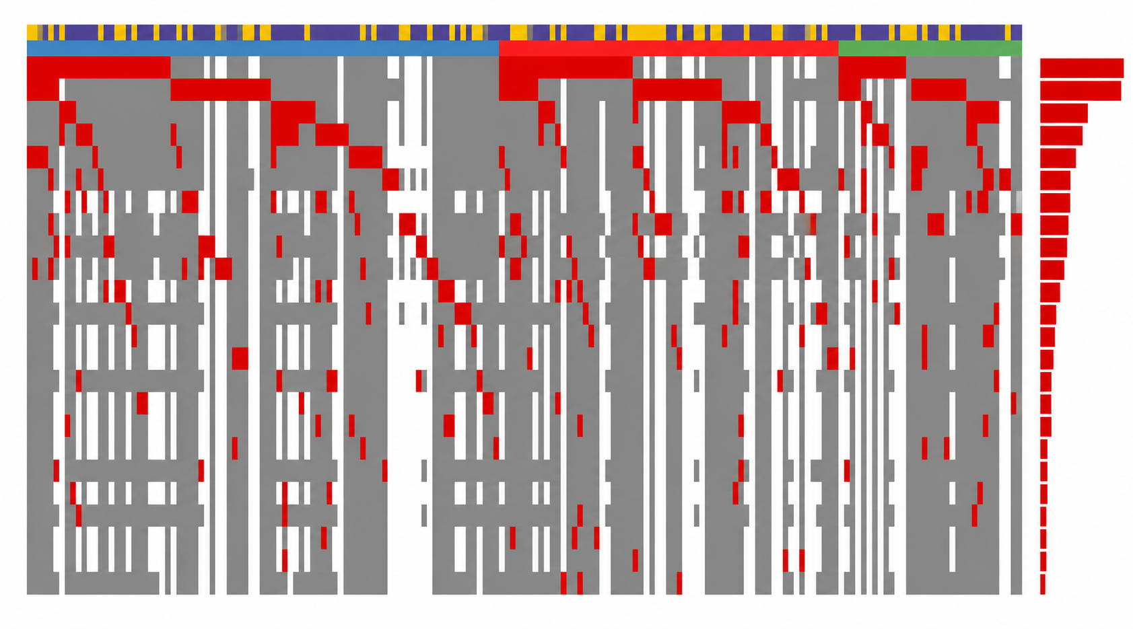

Clinical Outcomes in IDH1-Mutated AML by Race-Ethnicity (3)
AGE GROUP
RACE
DNMT3A
35 %
NPM1
34 %
ASXL1
17 %
RUNX1
15 %
NRAS
13 %
Age group
IDH2
12 %
SRSF2
12 %
Older
Wild type
FLT3-ITD
11 %
TET2
10 %
Mutated
FLT3-TKD
9 %
Younger
BCOR
8 %
TP53
6 %
Unknown
PHF6
6 %
Race
PTPN11
5 %
JAK2
4 %
Black
SF3B1
4 %
STAG2
4 %
CEBPA bZIP
3 %
Hispanic
KRAS
3 %
U2AF1
3 %
Asian
EZH2
2 %
WT1
2 %
ZRSR2
2 %
GATA2
2 %
Mutational landscapes were similar among different ethnicities/races
EHA 2026, Marvin-Peek J, abstract PS1642

Slide 23
Clinical Outcomes in IDH1-Mutated AML by Race-Ethnicity (4)
CR rate – frontline treatment
Overall survival
95%
100%
100%
1.0
NH-Black (all ages)
1.0
Hispanic (all ages)
82%
81%
85%
88%
67%
74%
76%
0.8
p < 0.001
0.8
HMA+VEN (n=14)
60%
CR rate (%)
0.6
Intensive (n=41)
0.6
Intensive (n=41)
Survival probability
Survival probability
0.4
0.4
HMA+IVO (n=10)
0%
0.2
HMA+VEN (n=23)
0.2
p = 0.43
Overall
IC
IC+IVO
0.0
HMA alone (n=10)
HMA+IVO (n=10)
0.0
0
25
50
75
100
125
0
50
100
150
100%
Months
Months
71%
75%
1.0
NH-Black (≥ 60 years)
1.0
Hispanic (≥ 60 years)
67%
CR rate (%)
54%
56%
50%
0.8
p < 0.001
0.8
38%
43%
28%
25%
0.6
0.6
HMA+IVO (n=9)
Survival probability
HMA+VEN (n=21)
Survival probability
0%
0.4
Intensive (n=16)
0.4
HMA+VEN (n=14)
HMA+VEN
HMA+IVO
HMA alone
0.2
0.2
p = 0.79
HMA+IVO (n=8)
Intensive (n=41)
0.0
HMA alone (n=10)
0.0
NH-White
Black
Hispanic
Asian
0
25
50
75
100
125
0
50
100
150
Months
Months
EHA 2026, Marvin-Peek J, abstract PS1642

Slide 24
Clinical Outcomes in IDH1-Mutated AML by Race-Ethnicity (5)
Conclusion
Treatment outcomes differed by race/ethnicity despite similar molecular profiles
Findings support the need for proportional race/ethnicity representation in pivotal AML trials
Diverse trial enrollment is essential to define efficacy and outcomes across populations
EHA 2026, Marvin-Peek J, abstract PS1642

Slide 25
Gilteritinib vs Midostaurin in FLT3-Mutated AML (1)
Trial design
HOVON156/AMLSG28-18/PASHA (NCT04027309) is a phase 3, multicenter, open-label trial conducted at 193 sites in 12 countries across Europe plus Australia (13 total)
Consolidation
Maintenance
(up to 1 year)
Induction
IDAC or ME + gilteritinib
Cycles 1 & 2
+ gilteritinib
AutoHSCT
Gilteritinib
Key inclusion criteria
Adults with FLT3^{mut} ND AML or MDS-EB2
FLT3-ITD or FLT3-TKD
ECOG PS score <2
Eligible for intensive chemo
R
1:1
AlloHSCT
IDAC or ME + midostaurin
Cycles 1 & 2
+ midostaurin
AutoHSCT
Midostaurin
AlloHSCT
EHA 2026, Raaijmakers M, abstract LB5005

Slide 26
Gilteritinib vs Midostaurin in FLT3-Mutated AML (2)
Primary endpoint - OS
100
Gilt: median NR
Mido: median NR
HR 1.02 (0.81 – 1.28); p = 0.864
Median FU: 43.2 months
Primary endpoint of OS was not met
80
Midostaurin
60
OS (%)
Gilteritinib
40
20
0
0
6
12
18
24
30
36
42
48
54
60
66
Follow-up time (months)
384
384
332
312
302
278
269
257
247
241
222
221
196
184
138
123
74
68
36
32
12
10
2
1
EHA 2026, Raaijmakers M, abstract LB5005

Slide 27
Gilteritinib vs Midostaurin in FLT3-Mutated AML (3)
Key secondary endpoint: EFS
100
Gilt: median 51.1 mo (24.7 - NR)
Mido: median 19.9 mo (14.3 – 35.7)
HR 0.83 (0.68 – 1.02); p = 0.052
Gilteritinib arm had a numerically
longer EFS
80
60
Gilteritinib
EFS (%)
40
Midostaurin
20
0
0
6
12
18
24
30
36
42
48
54
60
66
Follow-up time (months)
384
384
279
269
218
235
192
219
181
201
162
186
141
155
100
97
50
55
28
25
8
7
1
1
EHA 2026, Raaijmakers M, abstract LB5005

Slide 28
Gilteritinib vs Midostaurin in FLT3-Mutated AML (4)
Safety (Gilteritinib arm vs Midostaurin arm)
Grade ≥3 TEAE: 97% vs 97%
SAE: 68% vs 59%
  Infections 43% vs 36%
60-day mortality: 9% vs 6%
Neutrophil recovery after cycle 1 (median, days): 33 vs 28
Platelet recovery after cycle 1 (median, days): 31 vs 27
EHA 2026, Raaijmakers M, abstract LB5005

Slide 29
Gilteritinib vs Midostaurin in FLT3-Mutated AML (5)
Conclusions
First phase 3 head-to-head study comparing FLT3 inhibitors in AML
Similar OS with gilteritinib and midostaurin
Trend for better EFS/RFS with gilteritinib
Gilteritinib associated with slightly more infections and slower hematologic recovery
EHA 2026, Raaijmakers M, abstract LB5005

Slide 30
Efficacy of Revumenib in AML Harboring NPM1-mutated co-mutations: post-hoc analysis of AUGMENT 101 (1)
AUGMENT-101 study design
Study population
Phase 1: dose escalation
Phase 2: pivotal trial
Endpoints
(DCO: 19 Feb 2026)
Adult and pediatric patients with R/R NPM1m AML, KMT2Ar AL,
NUP98r AL
Revumenib RP2D
160 mg q12h orally (95 mg/m² if <40 kg) WITH strong CYP3A4i in 28-day cycles
KMT2Ar
  Cohort 2A:
  ALL, MPAL
Primary
CR + CRh rate
Safety and tolerability
Secondary
CRc rate
ORR
DOR
Time to response
Optional
  Cohort 2B:
  AML
≥PR
CRc
HSCT
Revumenib
NPM1m
  Cohort 2C: AML
  (Focus of this analysis)
FDA-approved dosage
160 mg q12h orally (95 mg/m² if <40 kg) WITH strong CYP3A4i in 28-day cycles
or
270 mg q12h orally (160 mg/m² if <40 kg) WITHOUT strong CYP3A4i in 28-day cycles
EHA 2026, Blachly J, abstract PF514

Slide 31
Efficacy of Revumenib in AML Harboring NPM1-mutated co-mutations: post-hoc analysis of AUGMENT 101 (2)
Patient characteristics
54 adults with centrally confirmed NPM1mut and targeted NGS results available
Median age 65.0 years (19-84); and median number of co-mutations was 3 (1-8)
Patients were heavily pretreated, median of 2 (1-7) prior lines of therapy
﻿﻿74% had prior venetoclax, 26% had prior HSCT, 48% had prior FLT3 inhibitors, and 4/6% had prior IDH1/2 inhibitors
EHA 2026, Blachly J, abstract PF514

Slide 32
Efficacy of Revumenib in AML Harboring NPM1-mutated co-mutations: post-hoc analysis of AUGMENT 101 (3)
Best overall response in selected co-mutation subgroup
ORR:
10 (71,4)
CR
ORR:
9 (60,0)
CRh
ORR:
11 (47,8)
ORR:
26 (48,1)
CRp
3 (20,0)
ORR:
8 (42,1)
CRi
1 (6,7)
4 (17,4)
8 (57,1)
11 (20,4)
3 (15,8)
MLFS
1 (6,7)
1 (4,3)
1 (6,7)
1 (4,3)
3 (5,6)
1 (1,9)
PR
1 (4,3)
2 (10,5)
1 (1,9)
2 (13,3)
3 (13,0)
1 (7,1)
1 (5,3)
8 (14,8)
1 (5,3)
1 (6,7)
1 (4,3)
1 (7,1)
1 (5,3)
2 (3,3)
DNMT3A +
FLT3
(n=15)
FLT3
(n=23)
IDH1/2
(n=14)
Common sAML
co-mutations
(n=19)
Total
(n=54)
EHA 2026, Blachly J, abstract PF514

Slide 33
Efficacy of Revumenib in AML Harboring NPM1-mutated co-mutations: post-hoc analysis of AUGMENT 101 (4)
Response rates and MRD-negativity rates in selected co-mutation subgroup
 | DNMT3A + FLT3 (n = 15) | FLT3 (п = 23) | IDH1/2 (n = 14) | Common sAML co-mutations (n = 19) | Total (N= 54)
CR + CRh rate, n (%) [95% CI] | 4 (26.7) [7.8-55.1] | 5 (21.7) [7.5-43.7] | 9 (64.3) [35.1-87.2] | 5 (26.3) [9.1-51.2] | 14 (25.9) [15.0-39.7]
MRD-negativity rate, n/N (%) | 4/4 (100) | 5/5 (100) | 8/9 (88.9) | 3/5 (60.0) | 9/14 (64.3)
CRc rate, n (%) [95% CI] | 6 (40.0) [16.3-67.7] | 7 (30.4) [13.2-52.9] | 9 (64.3) [35.1-87.2] | 7 (36.8) [16.3-61.6] | 16 (29.6) [18.0-43.6]
MRD-negativity rate, n/N (%) | 5/5 (100) | 6/6 (100) | 8/9 (88.9) | 4/6 (66.7) | 10/15 (66.7)
EHA 2026, Blachly J, abstract PF514

Slide 34
Efficacy of Revumenib in AML Harboring NPM1-mutated co-mutations: post-hoc analysis of AUGMENT 101 (5)
Conclusions
Revumenib demonstrated meaningful responses in patients with high-risk co-mutation profiles in R/R NPM1m AML population
EHA 2026, Blachly J, abstract PF514

Slide 35
OPTI-AML: 28 vs 14 Days VEN + AZA in Newly Diagnosed AML (1)
OPTI-AML Trial Design
Primary Objective: To compare CR rate with 28 days (AV28) vs. 14 days Ven (AV1 4) in combination with Aza across first 2 cycles in ND AML pts ≥60y unfit for intensive chemo.
Arm AV28
2 cycles
Ven Days 1-28
Aza 75 mg/m² Days 1-7
83 patients
Newly diagnosed
AML 60 yrs>older
Randomization 1:1
Stratified by age
60-74 vs. ≥75 years
N=169 patients
BM Biopsy on Day 21 of Each Cycle
Primary Endpoint:
CR across
2 cycles
Off Protocol
Treatment
Long-Term Follow-Up
Arm AV14
2 cycles
Ven Days 1-14
Aza 75 mg/m² Days 1-7
86 patients
Secondary Objectives: Composite CR, Progression-free Survival, Overall Survival, Neutrophil & Platelet Recovery, Safety & Toxicities
EHA 2026, Borate U, abstract S126

Slide 36
OPTI-AML: 28 vs 14 Days VEN + AZA in Newly Diagnosed AML (2)
Baseline Characteristics
Baseline Characteristics | AV28 (N=83) | AV14 (N=86) | Overall (N=169)
Age at consent, years, Median (range) | 72 (60-88) | 73 (60-90) | 73 (60-90)
Age ≥ 75 years, no. (%) | 33 (39.8) | 32 (37.2) | 65 (38.5)
Gender, no. (%) Female Male | 42 (50.6) 41 (49.4) | 30 (34.9) 56 (65.1) | 72 (42.6) 97 (57.4)
Race, no. (%) Caucasian African American Other Unknown | 71 (88.8) 6 (7.5) 3 (3.8) 3 | 76 (89.4) 7 (8.2) 2 (2.4) 1 | 147 (89.1) 13 (7.9) 5 (3.0) 4
Ethnicity, no. (%) Not Hispanic or Latino Hispanic or Latino Unknown | 80 (98.8) 1 (1.2) 2 | 82 (98.8) 1 (1.2) 3 | 162 (98.8) 2 (1.2) 5
ECOG Performance Status at Screening, no. (%) 0 1 2 Unknown | 27 (33.3) 40 (49.4) 14 (17.3) 2 | 24 (28.6) 40 (47.6) 20 (23.8) 2 | 51 (30.9) 80 (48.5) 34 (20.6) 4
Bone Marrow Blasts, %, Median (range) Unknown | 41 (1-98) 2 | 37.5 (0-93) 4 | 40 (0-98)
White Blood Cell Count, 10/L, Median (Range) | 2.9 (0.7-23.6) | 2.5 (0.3-22.7) | 2.6 (0.3-23.6)
Mutations, n (%) | AV28 (N=83) | AV14 (N=86) | Overall (N=169)
NPM1 | 6 (7.2) | 4 (4.7) | 10 (5.9)
IDH2 | 18 (21.7) | 11 (12.8) | 29 (17.2)
IDH1 | 7 (8.4) | 10 (11.6) | 17 (10.1)
NRAS | 5 (6.0) | 8 (9.3) | 13 (7.7)
KRAS | 4 (4.8) | 4 (4.7) | 8 (4.7)
FLT3 | 9 (10.8) | 10 (11.6) | 19 (11.2)
FLT3-ITD | 3 (3.6) | 7 (8.1) | 10 (5.9)
FLT3-TKD | 4 (4.8) | 3 (3.5) | 7 (4.1)
TP53 | 13 (15.7) | 19 (22.1) | 32 (18.9)
Cytogenetics, n (%) | AV28 (N=82) | AV14 (N=86) | Overall (N=168)
Core Binding Factor Unknown | 1 (1.3) 3 | 7 (8.2) 1 | 8 (4.9) 4
Complex Karyotype Unknown | 22 (27.9) 3 | 28 (32.9) 1 | 50 (30.5) 4
ELN Risk Classification, n (%). | AV28 | AV14 | Overall
ELN 2022 | (N=82) | (N=86) | (N=168)
Favorable | 10 (12.2) | 11 (12.8) | 21 (12.5)
Intermediate | 6 (7.3) | 9 (10.5) | 15 (8.9)
Adverse | 66 (80.5) | 66 (76.7) | 132 (78.6)
ELN 2024 | (N=83) | (N=86) | (N=169)
Favorable | 58 (70.0) | 52 (60.5) | 110 (65.1)
Intermediate | 12 (14.5) | 15 (17.4) | 27 (16.0)
Adverse | 13 (15.7) | 19 (22.1) | 32 (18.9)
EHA 2026, Borate U, abstract S126

Slide 37
OPTI-AML: 28 vs 14 Days VEN + AZA in Newly Diagnosed AML (3)
ORR rate :
cCR rate :
84,3 %
80,7 %
77,9 %
68,6 %
81,1 %
68,6 %
100
7,2 %
15,1 %
11,2 %
AV14
43,0 %
AV28
49,4 %
Complete remission rate :
75
Not assessed
Favors AV14
Favors AV28
16,9 %
13,0 %
SD
9,3 %
PR
10 %
14,5 %
15,4 %
MLFS
Response rate (%)
16,3 %
Difference in CR rates : 6,4 %
90% Confidence intervals : -6,1 % ; 19,0 %
50
CRi
CRh
AV28 - AV14
25
49,4 %
CR
43,0 %
46,2 %
0
AV28
(n = 83)
AV14
(n = 86)
Overall
(n = 169)
EHA 2026, Borate U, abstract S126

Slide 38
OPTI-AML: 28 vs 14 Days VEN + AZA in Newly Diagnosed AML (4)
CR Rates per Mutation Group, n/n (%) | AV28 | AV14
NPM1 | 5/6 (83.3) | 1/4 (25.0)
IDH2 | 10/18 (55.6) | 4/11 (36.4)
IDH1 | 5/7 (71.4) | 6/10 (60.0)
FLT3 | 7/9 (77.8) | 6/10 (60.0)
TP53 | 7/13 (53.9) | 11/19 (57.9)
Non TP53 | 30/70 (42.9) | 26/67 (38.8)
TP53 or CK | 10/24 (41.7) | 14/29(48.3)
NPM1/IDH2 | 14/23 (60.9) | 5/15 (33.3)
Non NPM1/IDH2 | 27/60 (45.0) | 32/71 (45.1)
CIR of Neutrophil Recovery to 1x10⁹/L by D42:
CIR, % (95% CI) | AV28 | AV14
Cycle 1 | 64% (48-77) | 77% (60-88)
Cycle 2 | 64% (49-76) | 49% (33-62)
CIR of Platelet Recovery to 100x10⁹/L by D42:
CIR, % (95% CI) | AV28 | AV14
Cycle 1 | 83% (69-91) | 89% (74-95)
Cycle 2 | 65% (50-77) | 61% (46-73)
EHA 2026, Borate U, abstract S126

Slide 39
OPTI-AML: 28 vs 14 Days VEN + AZA in Newly Diagnosed AML (5)
Univariable/Multivariable Regression Models for OS | Univariable models |  | Multivariable model
 | HR (95% CI) | p-value | HR (95% CI) | p-value
Arm, AV14 vs. AV28 | 1.53 (0.97-2.41) | 0.07 | 1.33 (0.83-2.12) | 0.23
Age, 5-years older | 1.23 (1.01-1.49) | 0.04 | ---- | ----
Sex, M vs. F | 1.30 (0.82-2.06) | 0.27 | ---- | ----
Race, White vs. non-white | 0.60 (0.30-1.21) | 0.16 | ---- | ----
ECOG PS, VS. 0 1 2 | 1.71 (0.96-3.04) 2.40 (1.26-4.59) | 0.07 0.0081 | 1.49(0.82-2.68) 2.47 (1.27-4.81) | 0.19 0.0078
Hemoglobin, 10-unit increase | 0.78 (0.66-0.93) | 0.0066 | ---- | ----
WBC, 1-unit increase | 1.03 (0.99-1.08) | 0.12 | ---- | ----
Platelet, 50-unit increase | 0.74 (0.59-0.93) | 0.0086 | ---- | ----
ANC, 1-unit increase | 0.95 (0.87-1.05) | 0.31 | ---- | ----
Complex karyotype | 2.30 (1.44-3.66) | 0.0005 | ---- | ----
CBF | 1.39 (0.60-3.21) | 0.44 | ---- | ----
NPM1 | 0.97 (0.42-2.25) | 0.94 | ---- | ----
IDH1 | 0.78 (0.34-1.79) | 0.56 | ---- | ----
IDH2 | 0.38 (0.17-0.82) | 0.01 | --- | ---
FLT3-ITD | 1.71 (0.82-3.57) | 0.15 | ---- | ----
NRAS | 1.33 (0.61-2.91) | 0.47 | ---- | ----
KRAS | 2.53 (1.00-6.41) | 0.05 | 3.48 (1.31-9.25) | 0.01
TP53 | 2.54 (1.53-4.23) | 0.003 | 3.14 (1.80-5.47) | <.0001
ELN 2022, VS. Adverse Favorable Intermediate | 0.83 (0.44-1.59) 0.53 (0.21-1.33) | 0.58 0.18 | ---- | ----
ELN 2024, vs Adverse Favorable Intermediate | 0.34(0.20-0.58) 0.65 (0.34-1.25) | <.0001 0.2 | ---- | ----
Usage of G-CSF, vs. No | 0.96 (0.55-1.66) | 0.87 | ---- | ----
EHA 2026, Borate U, abstract S126

Slide 40
OPTI-AML: 28 vs 14 Days VEN + AZA in Newly Diagnosed AML (6)
Conclusions
﻿﻿AV14 did not demonstrate non-inferiority to AV28
﻿﻿CR benefit with AV 28 was driven by NPM1/IDH2 with similar responses in other groups. The two arms had genomic imbalances making broad interpretation challenging
﻿﻿Toxicity profile was similar across arms
The study highlight the importance of randomized trials and caution against Ven duration adjustments without prospective data
﻿﻿Further study is warranted assessing different Ven schedules in select molecular subsets
EHA 2026, Borate U, abstract S126

Slide 41

LD-VENEX: Reduced-Duration VEN + AZA in AML in de novo AML, secondary AML and RR AML (1)
Primary endpoint
ORR (CR/CRh/CRi/MLFS/PR)
CRc (CR/CRh/CRi)
Secondary endpoints
Overall Survival, Duration of Response, Progression Free Survival
Adverse Events - Haematological Toxicity grade ≥ 3
Exploratory endpoints Quality of Life and ex vivo analysis to predict treatment response
Study design
28-day cycles (C1 - C24)
EOT
5 y follow-up
Cycle 1*
Cycle 2 - 3
Cycle 4 - 24
Azacitidine 75mg/m2 D1-7
Venetoclax 400 mg D1-14 > D1-7*
EHA 2026, Toboll Soresen A-L, abstract S129

Slide 42
LD-VENEX: Reduced-Duration VEN + AZA in AML in de novo AML, secondary AML and RR AML (2)
LD-VenEx: Patient Baseline Characteristics
Characteristic | de novo AML (N=83) | sAML (N=33) | R/R AML (N=36)
Age, median (min, max) - years Median (min, max) Age ≥75 years | 75 (56, 84) 49 (59%) | 76 (64, 83) 22 (67%) | 71 (43, 79) 9 (25%)
Sex Female Male | 32 (39%) 51 (61%) | 12 (36%) 21 (64%) | 14 (39%) 22 (61%)
ECOG Performance Status 0-1 2-3 | 65 (78%) 17 (20%) | 29 (88%) 3 (9%) | 33 (92%) 3 (8%)
Secondary AML Previously treated Previously untreated | - - | 19 (58%) 14 (42%) | - -
Relapsed/refractory AML Prior lines of therapy 1-2 lines 2-3 lines Prior Allo-HSCT | - - - | - - - | 23 (64%) 13 (36%) 10 (28%)
Characteristic | de novo AML (N=83) | sAML (N=33) | R/R AML (N=36)
Cytogenetic alterations
Normal karyotype | 35 (42%) | 22 (67%) | 15 (42%)
Adverse risk karyotype | 24 (29%) | 9 (27%) | 7 (19%)
del(5) or del (5q) | 10 (12%) | 3 (9%) | 0 (0%)
del(7) or del (7q) | 9 (11%) | 7 (21%) | 2 (6%)
del(17p) / abn(17p) | 6 (7%) | 2 (6%) | 2 (6%)
Complex karyotype | 17 (20%) | 3 (9%) | 3 (8%)
Somatic mutations
NPM1 | 14 (17%) | 3 (9%) | 3 (8%)
IDH1 | 8 (10%) | 2 (6%) | 3 (8%)
IDH2 | 12 (14%) | 6 (18%) | 6 (17%)
FLT3-ITD | 8 (10%) | 3 (9%) | 4 (11%)
NRAS | 12 (14%) | 8 (24%) | 3 (8%)
KRAS | 6 (7%) | 3 (9%) | 2 (6%)
TP53 | 22 (27%) | 4 (12%) | 4 (11%)
AML with myelodysplasia-related changes | 44 (53%) | 25 (76%) | 14 (39%)
ELN 2022 risk classification
Favorable | 12 (14%) | 3 (9%) | 3 (8%)
Intermediate | 12 (14%) | 3 (9%) | 16 (44%)
Adverse | 58 (70%) | 27 (82%) | 17 (47%)
ELN 2024 risk classification*
Favorable | 15 (18%) | 7 (21%) | 5 (14%)
Intermediate | 46 (55%) | 22 (67%) | 27 (75%)
Adverse | 22 (27%) | 4 (12%) | 4 (11%)
EHA 2026, Toboll Soresen A-L, abstract S129

Slide 43
LD-VENEX: Reduced-Duration VEN + AZA in AML in de novo AML, secondary AML and RR AML (3)
LD-VenEx: Efficacy Outcomes — ORR and CRc
Overall Response Rates (N=152)
Time to First Response (mo, 95% CI)
  Time to First ORR: 1.0 (1.0 - 1.1)
  Time to First CRc: 1.0 (1.0 - 1.8)
Data on MRD status pending
ORR 81%
CRc 70%
ORR 79%
CRc 52%
ORR 69%
CRc 64%
CR
Allogenic transplantation (n, (%)
CRh
Percentage of patients
CRi
All (N=152) | dnAML (N=83) | SAML (N=33) | R/R AML (N=36)
22 (14) | 13 (16) | 4 (12) | 5 (14)
MLFS
PR
EHA 2026, Toboll Soresen A-L, abstract S129

Slide 44
LD-VENEX: Reduced-Duration VEN + AZA in AML in de novo AML, secondary AML and RR AML (4)
LD-VenEx: Efficacy Outcomes
Overall Survival Stratified by ELN2024 Risk Category
Overall survival by AML Cohort (N=152)
Overall survival newly diagnosed AML (N=97)
median follow-up 24,8 mo, data cut-off 31 May 2026
(de novo AML + untreated sAML)
1,00
1,00
Favorable
Intermediate
Adverse
0,88
0,88
Fav risk mOS 15.5 mo (95% CI 11.3-NR)
Int risk mOS 29,0 (95% CI 14.1-NR)
Adv risk mOS 7.6 mo (95% CI 6.4-14.3)
0,75
dnAML mOS 15.5 mo (95% CI 11.2-NR)
sAML mOS 13.0 mo (95% CI 8.3-17.2)
R/R AML mOS 13.0 mo (95% CI 6.4-16)
0,75
0,62
0,62
Survival probability
0,50
0,50
Survival probability
0,38
0,38
0,25
de novo AML
sAML
R/R AML
0,25
0,12
0,12
0,00
0,00
0
6
12
18
24
30
36
42
48
0
6
12
18
24
30
36
42
48
Time (months)
Time (months)
de novo AML
sAML
R/R AML
83
36
33
64
26
23
36
19
15
24
10
6
17
7
2
11
2
2
4
0
1
1
0
1
0
0
0
Favorable
Intermediate
Adverse
19
54
24
16
44
16
10
30
4
4
22
2
3
12
2
1
8
2
0
3
1
0
0
1
0
0
0
Mortality
  30-day mortality rate 3.3% (5/152)
  60-day mortality rate 9.9% (15/152)
EHA 2026, Toboll Soresen A-L, abstract S129

Slide 45
LD-VENEX: Reduced-Duration VEN + AZA in AML in de novo AML, secondary AML and RR AML (5)
Conclusions
In the prospective LD-VenEx trial efficacy of VEN/AZA with reduced duration of venetoclax 14 days > 7 days after blast clearance is comparable to labelled dose in both frontline and R/R settings
  ﻿﻿De novo AML : CRc 70%, median OS 15.5 months
  ﻿﻿Secondary AML: CRc 52%, median OS 13.0 months
  ﻿﻿Relapsed/refractory AML: CRc 64%, median OS 13.0 months
However, this may not hold true for the favorable group, which showed a significantly lower OS than expected, possibly due to the reduced duration of venetoclax exposure.
﻿﻿﻿﻿Treatment was safely administered in the outpatient setting, also during cycle 1
﻿﻿Significant cost reduction
EHA 2026, Toboll Soresen A-L, abstract S129

Slide 46
IDH1 Testing and Frontline Treatment Patterns in AML (1)
Aim
  To assess real-world IDH1 testing practices in patients with AML ineligible for intensive therapy and receiving first-line (1L) treatment across Europe (France, Germany, Italy, Spain, and the UK).
  To evaluate testing technologies, treatment patterns, and physician satisfaction in the treatment of patients with AML ineligible for intensive therapy.
Methods
  Retrospective analysis of IQVIA Oncology Dynamics survey data.
  Study period: July 2024–June 2025.
Population:
  Patients with AML receiving first-line treatment and ineligible for intensive chemotherapy per ELN-based criteria (age, ECOG PS, comorbidities).
Key outcomes:
  IDH1 testing rates, clinical setting for testing (academic vs. non-academic centers), use of NGS, IDH1 mutation positivity, 1L treatment patterns and physician-reported satisfaction
  Interpretation of physician-reported satisfaction: less satisfied (score 1-3), neutral (score 4), and more satisfied (score 5-7).
    To avoid biasing the response, no guidance was given for the ratings.
EHA 2026, Isidori A, abstract PF517

Slide 47

IDH1 Testing and Frontline Treatment Patterns in AML (2)
Patient Cohort
A total of 1065 patients were included in the study
Patient distribution:
  Italy (333)
  Spain (260)
  France (182)
  Germany (159)
  UK (131)
Patient distribution by country
131
159
182
333
260
EHA 2026, Isidori A, abstract PF517

Slide 48
IDH1 Testing and Frontline Treatment Patterns in AML (3)
IDH1 Testing rate by country
The overall testing rate was 79.9% (851/1065)
The highest testing rates were reported in France (93.4%) and the UK (86.3%), while the lowest testing rate was in Italy (64.4%)
%
79,9 %
64,4 %
83,8 %
93,4 %
84,9 %
86,3 %
100
7,1 %
11,2 %
9,9 %
12,7 %
9,4 %
19,1 %
80
60
62,3 %
48,6 %
59,6 %
73,6 %
82,4 %
60,3 %
40
6,0 %
20
6,5 %
11,5 %
35,4 %
1,9 %
6,9 %
20,1 %
16,2 %
3,8 %
15,1 %
13,7 %
0
6,6 %
All
(n=1066)
Italy
(n=333)
Spain
(n=260)
France
(n=182)
Germany
(n=159)
UK
(n=131)
Tested population:
IDH1-positive
IDH1-negative
Awaiting results
Non-tested population:
Not tested
EHA 2026, Isidori A, abstract PF517

Slide 49
IDH1 Testing and Frontline Treatment Patterns in AML (4)
Clinical Setting for Testing
  Testing were predominantly performed in academic centers in Spain (90.4%), the UK (69.9%), and Germany (63.0%), while non-academic centers predominated in France (55.9%) and Italy (54.9%).
First-Line Treatment (IDH1+)
Most common first-line treatments (>10%) among patients with positive IDH1 status (n=119):
  Venetoclax + azacitidine: 47.1% (n=56)
  Ivosidenib + azacitidine: 16.0% (n=19)
  Azacitidine monotherapy: 12.6% (n=15)
Italy
45,1 %
54,9 %
Spain
90,4 %
9,6 %
Physician Satisfaction
Physician satisfaction was highest for:
  Venetoclax + azacitidine: 53.6% (n=30)
  Ivosidenib + azacitidine: 94.7% (n=18)
France
44,1 %
55,9 %
Germany
63,0 %
37,0 %
UK
69,9 %
30,1 %
% in Academic setting
% in non-Academic setting
EHA 2026, Isidori A, abstract PF517

Slide 50
IDH1 Testing and Frontline Treatment Patterns in AML (5)
Conclusions
IDH1 testing rates are generally high but show notable inter-country variability.
Substantial differences exist in clinical settings for testing, use of NGS, and treatment selection.
Opportunities remain to:
  Optimise molecular testing strategies
  Improve treatment decision-making in routine clinical practice
EHA 2026, Isidori A, abstract PF517

Slide 51
Frontline Treatment Intensity and Survival in IDH-Mutated AML (1)
INTRODUCTION
﻿﻿IDH1/2 mutations are recurrent genomic alterations in acute myeloid leukemia (AML).
﻿﻿Frontline treatment selection is largely guided by patient fitness, with intensive chemotherapy (IC)
commonly used in fit, young patients, while lower-intensity therapy (LIT) is often used in older or unfit patients.
﻿﻿Comparative survival data between IC and LIT in IDH-mutated AML remain inconclusive, with no definitive evidence favoring one frontline strategy over the other.
AIM
﻿﻿To compare clinical response and survival outcomes among patients with IDH-mutated AML treated with
IC versus LIT.
METHOD
﻿﻿Retrospective review of AML patients at Mayo Clinic, Rochester with available NGS data, 2016-2024.
﻿﻿Included patients with IDH1/IDH2-mutated
AML treated frontline with:
  ﻿﻿IC: 7+3 - based chemotherapy
  ﻿﻿LIT: HMA ± venetoclax
﻿﻿Excluded patients who received frontline
IDH-targeted therapy.
﻿﻿Primary outcomes: Complete Remission
(CR), Composite CR (CCR), Progression-free Survival (PFS), and Overall Survival (OS).
﻿﻿Secondary outcomes: Overall Response
Rate (ORR), death/hematopoietic stem cell transplantation (HSCT)-free survival, and subgroup survival analyses by age, HSCT status, cytogenetic risk, and baseline IDH variant allele frequency (VAF).
EHA 2026, Kewan T, abstract PS1645

Slide 52
Frontline Treatment Intensity and Survival in IDH-Mutated AML (2)
Overall survival by frontline treatment intensity
Progression-free survival by frontline treatment intensity
Multivariate Cox regression analysis for overall survival
OS was not significantly different between IC and LIT
(median OS: not reached vs 29.5 months; p=0.094)
PFS did not significantly differ between IC and LIT (p=0.32)
Treatment intensity was not independently associated with OS,
while HSCT remains associated with improved survival (HR 0.44; p=0.04)
1.00
IC
1.00
IC
HR (95% CI), p
0.75
LIT
0.75
LIT
Second-line IDH inhibitors
1.31 (0.56-2.82), p=0.51
Overall survival probability
Progression-free survival probability
CR
0.59 (0.29-1.18), p=0.14
0.50
0.50
IDH VAF
1.01 (0.98-1.04), p=0.45
0.25
p = 0.094
0.25
p = 0.32
Transplant
0.44 (0.18-0.97), p=0.04
0.00
0.00
Complex karyotype
0.80 (0.23-2.10), p=0.68
0
12
24
36
48
60
72
84
96
0
12
24
36
48
60
72
84
96
Age
1.02 (0.99-1.06), p=0.28
Months elapsed
Months elapsed
Treatment (IC vs LIT)
1.28 (0.52-3.06), p=0.59
IC
48
40
25
21
15
12
7
3
2
IC
48
40
25
21
15
12
7
3
2
LIT
46
32
14
10
7
2
1
0
0
LIT
46
32
14
10
7
2
1
0
0
0.1
1
10
94/625 molecularly annotated AML patients had IDH-mutated AML; 48 received IC and 46 received LIT as frontline therapy
﻿﻿The IC group was younger than the LIT group: median age 62 vs 75 years; p < 0.001
﻿﻿IC-treated patients more frequently had normal karyotype: 65% vs 35%; p = 0.006
﻿﻿Allogeneic HSCT was more common after IC: 67% vs 17%; p < 0.001
﻿﻿IC achieved higher CR rates: 67% vs 37%; p = 0.003, but OS and PFS were not significantly different between IC and LIT
﻿﻿In multivariable analysis, IC was not independently associated with OS, whereas HSCT remained associated with improved OS: HR 0.44; p = 0.04
EHA 2026, Kewan T, abstract PS1645

Slide 53
Frontline Treatment Intensity and Survival in IDH-Mutated AML (3)
Conclusions
Frontline IC vs LIT did not significantly impact OS in patients with IDH-mutated AML
Although IC achieved higher CR rates, treatment intensity was not independently associated with OS after adjustment
HSCT remained the strongest survival correlate, highlighting the importance of downstream consolidation and the need to optimize integration of venetoclax-, IDH inhibitor-, and transplant-based strategies
Separate studies by group mutations and transplant eligibility are needed to understand who benefit better of IC or LIT
EHA 2026, Kewan T, abstract PS1645

Slide 54
Post-Transplant Revumenib in KMT2Ar, NPM1m, and NUP98r AML: AUGMENT-101 (1)
Revumenib, a first-in-class, oral, potent, and selective inhibitor of the menin-KMT2A interaction, is used for the treatment of relapsed/refractory (R/R) AML harboring an NPM1 mutation (NPM1m) or R/R acute leukemia with a KMT2A translocation in adult and pediatric patients 1 year and older
Preclinical data indicate that menin inhibition may also enhance donor T-cell antitumor activity, which supports revumenib as a potential post-HSCT maintenance treatment and thus as a strategy to reduce the risk of relapse
AUGMENT-101 study design
Phase 1: dose escalation
Phase 2: Pivotal trial
Phase 2 endpoints
(DCO: 19 Feb 2026)
Revumenib RP2D
160 mg q12h orally
(95 mg/m² if <40 kg)
WITH strong CYP3A4i
in 28-day cycles
Primary
CR + CRh rate
Safety and tolerability
Secondary
CRc rate
ORR
DOR
Time to response
EFS
OS
KMT2Ar
Cohort 2A: ALL, MPAL
Optional
Study population
>PR
CRc
Adult and pediatric patients with R/R NPM1m AML, KMT2Ar AL,
or AL with genetic alterations that upregulate HOX
(including NUP98r)
Cohort 2B: AML
HSCT
Revumenib
NPM1m
Cohort 2C: AML
30 - 180 days after HSCT,
CRc, engraftment
no acute or chronic graft-versus-host disease (GVHD) that required immunosuppression
Revumenib dose remained the same as prior HSCT
FDA approved dosage
160 mg q12h orally (95 mg/m² if <40 kg) WITH strong CYP3A4i in
28-day cycles*
or
270 mg q12h orally (160 mg/m² if <40 kg) WITHOUT strong CYP3A4i in 28-day cycles*
EHA 2026, Žučenka A, abstract PS1631

Slide 55
Post-Transplant Revumenib in KMT2Ar, NPM1m, and NUP98r AML: AUGMENT-101 (2) - Results
Demographics and Baseline characteristics
19/59 (32%) patients with R/R AML who received HSCT after achieving a response with revumenib monotherapy had resumed revumenib treatment after HSCT
Four (21%) patients had NPM1m AML, 14 (74%) had KMT2Ar, and 1 (5%) had NUP98r (Table 1)
Two of 4 patients with NPM1m had co-mutations (IDH1, DNMT3A, and FLT3-ITD)
Duration of treatment:
  Median (range) duration of post-HSCT maintenance therapy was 20.0 (2.0-137.0) weeks
Efficacy:
  Median relapse-free survival was not reached in patients receiving post-HSCT revumenib, regardless of genotype, and 78.6% of patients remained alive and relapse-free at 12 months (85.1% in KMT2Ar)
  Median OS was not reached in patients receiving post-HSCT revumenib, regardless of genotype
 | NPM1m (n = 4) | KMT2Ar (n = 14) | NUP98r (n = 1) | Total (n = 19)
Age, median (range), y | 42,5 (19,0-56,0) | 40,0 (1,3-75,0) | 17,0 (17,0-17,0) | 39,0 (1,3-75,0)
Age, group, n (%)
< 18y | 0 | 3 (21) | 1 (100) | 4 (21)
18-<65y | 4 (100) | 10 (71) | 0 | 14 (74)
≥65y | 0 | 1 (7) | 0 | 1 (5)
Female, n (%) | 3 (75) | 6 (43) | 0 | 9 (47)
Race, n (%)
White | 4 (100) | 8 (57) | 1 (100) | 13 (68)
Non-white | 0 | 3 (21) | 0 | 3 (16)
Unknown | 0 | 3 (21) | 0 | 3 (16)
N of prior lines of therapy, median (range) | 2 (1-7) | 2 (1-6) | 5 (5-5) | 2 (1-7)
Disease status at baseline, n (%)
Primary refractory | 0 | 4 (29) | 0 | 4 (21)
Refractory relapse | 2 (50) | 6 (43) | 1 (100) | 9 (47)
Early untreated relapse | 1 (25) | 2 (14) | 0 | 3 (16)
Late untreated relapse | 1 (25) | 2 (14) | 0 | 3 (16)
Prior treatment, n (%)
Venetoclax | 2 (50) | 6 (43) | 1 (100) | 9 (47)
HSCT | 2 (50) | 7 (50) | 1 (100) | 10 (53)
Days from HSCT to initiating revumenib treatment, median (range) | 43 (40-59) | 78 (34-181) | 145 (145-145) | 65 (34-181)
EHA 2026, Žučenka A, abstract PS1631

Slide 56
Post-Transplant Revumenib in KMT2Ar, NPM1m, and NUP98r AML: AUGMENT-101 (3) - Safety
The most common Grade 3-4 TEAE was thrombocytopenia (42%)
11/19 (58%) patients had dose interruptions during treatment.
Reasons for skipped doses:
  platelet count decreased/thrombocytopenia (6/19; 32%),
  nausea/vomiting (3/19; 16%), neutropenia (1/19; 5%), and GVHD (3/19; 16%)
One grade ≥2 QTcF prolongation event occurred in 1 (5%) patient, lasting 1 day, and was unrelated to revumenib
No differentiation syndrome events were reported with revumenib post-HSCT maintenance therapy
GVHD occurred in 4 (21%) patients (onset 17 to 83 days after revumenib initiation). Three events were grade 3, and none were considered related to revumenib
Neutrophil and platelet counts in individual
patients over time during post-HSCT maintenance
18
16
14
12
10
Neutrophil (10⁹/l)
8
6
4
2
0
C5
C10
C15
C20
C25
C30
C33
Post-HSCT visit
2
2
2
Platelets (10⁹/l)
2
2
2
C5
C10
C15
C20
C25
C30
C33
Post-HSCT visit
NPM1m
KMT2Ar
NUP98r
1
3
5
7
9
11
13
15
17
19
2
4
6
8
10
12
15
16
18
EHA 2026, Žučenka A, abstract PS1631

Slide 57
Post-Transplant Revumenib in KMT2Ar, NPM1m, and NUP98r AML: AUGMENT-101 (4) - Conclusion
Revumenib demonstrated promising efficacy and a tolerable safety profile as post-HSCT maintenance treatment in adult and pediatric patients with R/R NPM1m, KMT2Ar, and NUP98r AML
Sustained relapse-free survival across genotypes supports the potential ability of revumenib to reduce post-HSCT relapse in this high-risk population
The safety profile of revumenib was consistent with that of the broader AUGMENT-101 trial and no differentiation syndrome was reported
  No patients discontinued treatment due to cytopenias
Collectively, these data support continued evaluation of revumenib as a post-HSCT maintenance treatment, with ongoing assessment in the post-transplant setting (NCT06575296)
EHA 2026, Žučenka A, abstract PS1631

Slide 58
Revumenib Maintenance After Allogeneic SCT in AML (1)
A single-center, pooled analysis of patients with
  NPM1mt,
  KMT2Ar,
  or NUP98r
AML treated with revumenib prior to HSCT on Augment 101, SAVE trials or EAP who resumed post-HSCT revumenib maintenance
EHA 2026, Goulart H, abstract PS1629

Slide 59
Revumenib Maintenance After Allogeneic SCT in AML (2)
Baseline characteristics
Transplant characteristics
 | All Patients (N = 24) | Adult (N = 13) | Pediatric (N = 11)
Median age, years | 22 [1-74] | 58 [21-74] | 13 [1-17]
Female | 14 (58) | 10 (77) | 4 (36)
Genotype NPM1mt KMT2Ar NUP98r | 6 (25) 17 (71) 1 (4) | 6 (46) 7 (54) 0 (0) | 0 (0) 10 (91) 1 (9)
Prior HSCT | 13 (54) | 5 (38) | 8 (73)
Lines of Therapy | 3 [1-11] | 3 [1-11] | 3 [1-6]
CR Status at HSCT CR1 CR2+ | 6 (25) 18 (75) | 5 (38) 8 (62) | 1 (9) 10 (91)
Regimen Pre-HSCT Revumenib Monotherapy SAVE | 10 (42) 14 (58) | 4 (31) 9 (69) | 6 (55) 5 (45)
 | All Patients (N = 24) | Adult (N = 13) | Pediatric (N = 11)
Type of HSCT MUD Haplo MSD Cord MMUD | 9 (38) 5 (21) 4 (17) 4 (17) 2 (8) | 8 (62) 2 (15) 2 (15) 0 (0) 1 (8) | 1 (9) 3 (27) 2 (18) 4 (36) 1 (9)
Conditioning Reduced Intensity Myeloablative | 9 (38) 15 (63) | 8 (62) 5 (38) | 1 (9) 0 (0) 10 (91)
GVHD Prophylaxis Tacrolimus PTCy | 21 (88) 13 (54) | 10 (77) 9 (69) | 11 (100) 5 (46)
Time to Revumenib | 82 [42 - 174] | 62 [42 - 133] | 116 [57 - 174]
EHA 2026, Goulart H, abstract PS1629

Slide 60
Revumenib Maintenance After Allogeneic SCT in AML (3)
Treatment Emergent Adverse Events (TEAE)
Measurable Residual Disease Status
TEAES | All Grades | ≥Grade 3 | AE with Dose Interruption/ Reduction | AE with Discontinuation
Thrombocytopenia | 20 (83) | 11 (46) | 11 (46) | 3 (13)
Neutropenia | 5 (21) | 1 (4) | 1 (4) | 1 (4)
Infection | 4 (17) | 2 (8) | 2 (8) | 1 (4)
GVHD | 3 (13) | 1 (4) | 0 (0) | 0 (0)
Nausea/vomiting | 2 (8) | 0 (0) | 1 (4) | 0 (0)
Elevated LFTs | 1 (4) | 0 (0) | 0 (0) | 0 (0)
Diarrhea | 1 (4) | 1 (4) | 0 (0) | 0 (0)
Prolonged QTcF | 0 (0) | 0 (0) | 0 (0) | 0 (0)
Differentiation syndrome | 0 (0) | 0 (0) | 0 (0) | 0 (0)
Characteristic (N = 24) | All patients (N=24) | Adult (N = 13) | Pediatric (N = 11)
MFC MRD Pre-HSCT Negative Positive Unknown | 19 (79) 2 (8) 3 (13) | 12 (92) 1 (8) 0 (0) | 7 (64) 1 (9) 3 (27)
MFC MRD Post-HSCT Negative Positive Unknown | 21 (88) 0 (0) 3 (13) | 11 (85) 0 (0) 2 (15) | 10 (91) 0 (0) 1 (9)
NPM1 NGS+ MRD Pre- Maintenance Negative Below Level of Detection | 2/5 (40) 3/5 (60) | 2/5 (40) 3/5 (60) | -
NPM1 NGS MRD Post- Maintenance Negative Positive | 4/5 (80) 1 (20) | 4/5 (80) 1 (20) | -
EHA 2026, Goulart H, abstract PS1629

Slide 61
Revumenib Maintenance After Allogeneic SCT in AML (4)
Survival of entire cohort
Median follow-up: 21 months (0.95 CI 14.4 - 44.7)
100
100
Median duration of revumenib post-HSCT:
10 months (0.5-36 months)
75
75
EFS (%)
50
Event-free survival
1-year
2-year
OS (%)
50
Overall survival
1-year
2-year
25
All patients
82%
72%
25
All patients
90%
90%
0
0
0
6
12
18
24
30
36
42
48
0
6
12
18
24
30
36
42
48
Months
Months
Survival in adult vs pediatric
At last follow-up, 24% remain on revumenib, and 76% have discontinued (relapse 14%, toxicity 19%, completion 14%, pt choice 14%, other illness 9%).
100
100
75
75
EFS (%)
50
OS (%)
50
Event-free survival
1-year
2-year
Overall survival
1-year
2-year
25
p=0.24
Adult
75%
49%
25
p=0.2
Adult
78%
78%
0
Pediatric
91%
91%
0
Pediatric
100%
100%
0
6
12
18
24
30
36
42
48
0
6
12
18
24
30
36
42
48
Months
Months
EHA 2026, Goulart H, abstract PS1629

Slide 62
Revumenib Maintenance After Allogeneic SCT in AML (5)
Conclusions
Revumenib as maintenance post-HSCT was feasible with no unexpected safety signals
﻿﻿Thrombocytopenia was common, occurring in 83% of patients (grade ≥3 46%), however this was manageable with dose modifications
﻿﻿In the heavily pre-treated cohort (CR2+ 74%, prior HSCT>50%), survival outcomes appear encouraging relative to historical expectations with 2-year overall survival and event-free survival rates of 90% and 72%, respectively
﻿﻿Limitations include the small, single-arm design with heterogeneity in disease biology
﻿﻿These findings support further prospective evaluation of menin inhibition as maintenance therapy post-HSCT
EHA 2026, Goulart H, abstract PS1629
Notes:
REFERENCES
1. Grembecka J et al. Nat Chem Biol 2012
2. Uckelmann HJ et al. Science 2020
3. Heikamp EB et al. Blood 2022
4. Issa G et al. J Clin Oncol 2025
5. Arellano M et al. Blood 2025
6. Fetcsch V et al. Blood 2026
7. Hoegeling SM et al, Haematologica 2025

Slide 63
Long-Term Follow-Up of Revumenib in Pediatric/YA KMT2A-r Acute Leukemia (1)
Introduction, aims, methods
KMT2A rearrangements (KMT2Ar) are frequently present in patients with acute leukemia (AL) and are associated with aggressive disease with high relapse rates. In pediatric pts, 5-y event-free survival (EFS) ranges from 29%–61%, and 44%–65% for overall survival (OS).
Revumenib, a first-in-class, oral, potent, and selective inhibitor of the menin-KMT2A interaction, is used for the treatment (tx) of relapsed/refractory (R/R) AL harboring a KMT2A translocation or R/R acute myeloid leukemia (AML) with NPM1 mutation in adult and pediatric pts 1 year and older.
AUGMENT-101 study design
Phase 1: dose escalation
Phase 2: Pivotal trial
Phase 2 endpoints
(DCO: 19 Feb 2026)
Revumenib RP2D
160 mg q12h orally
(95 mg/m² if <40 kg)
WITH strong CYP3A4i
in 28-day cycles
Primary
CR + CRh rate
Safety and tolerability
Secondary
CRc rate
ORR
DOR
Time to response
EFS
OS
KMT2Ar
Cohort 2A: ALL, MPAL
Optional
Study population
>PR
CRc
Adult and pediatric patients with R/R NPM1m AML, KMT2Ar AL,
or AL with genetic alterations that upregulate HOX
(including NUP98r)
Cohort 2B: AML
HSCT
Revumenib
NPM1m
Cohort 2C: AML
FDA approved dosage
160 mg q12h orally (95 mg/m² if <40 kg) WITH strong CYP3A4i in
28-day cycles*
or
270 mg q12h orally (160 mg/m² if <40 kg) WITHOUT strong CYP3A4i in 28-day cycles*
EHA 2026, Cuglievan B, abstract PS508

Slide 64
Long-Term Follow-Up of Revumenib in Pediatric/YA KMT2A-r Acute Leukemia (2)
Demographic baseline characteristics
 | AML (27) | ALL (8) | MPAL (3) | Total (38)
Age, median (range), y | 6.0 (1.3-20.0) | 2.5 (0.6-20.0) | 1.5 (1.0-2.0) | 5.0 (0.6-20.0)
Age group, n (%) 0-<2 y 2-<12 y 12-<17 y 17-20 y | 4 (15) 15 (56) 4 (15) 4 (15) | 1 (13) 5 (63) 1 (13) 1 (13) | 2 (67) 1 (33) 0 0 | 7 (18) 21 (55) 5 (13) 5 (13)
Female, n (%) | 16 (59) | 5 (63) | 2 (67) | 23(61)
Race, n (%) White Non-White’ Unknown | 19 (70) 4 (15) 4 (15) | 2 (25) 3 (38) 3 (38) | 1 (33) 0 2 (67) | 22 (58) 7 (18) 9 (24)
Disease status at baseline, n (%) Primary refractory Refractory relapse Early untreated relapse | 5 (19) 16 (59) 6 (22) | 2 (25) 5 (63) 1 (13) | 0 3 (100) 0 | 7 (18) 24 (63) 7 (18)
No. of prior lines of therapy, median (range) | 3.0 (1-11) | 4.0 (1-9) | 4.0 (2-4) | 3.0 (1-11)
Prior therapy, n (%) Venetoclax HSCT CAR-T | 16 (59) 15 (56) 1 (4) | 4 (50) 2 (25) 4 (50) | 1 (33) 2 (67) 1 (33) | 21 (55) 19 (50) 6 (16)
EHA 2026, Cuglievan B, abstract PS508

Slide 65
Long-Term Follow-Up of Revumenib in Pediatric/YA KMT2A-r Acute Leukemia (3)
Efficacy
In the efficacy population (N=36), CR+CRh rate was 30.8% (8/26) in AML, 14.3% (1/7) in ALL, and 33.3% (1/3) in MPAL pts
Measurable residual disease negativity for CR+CRh was achieved by 6/7 pts with AML and 1/1 with MPAL
All subgroups demonstrated responses in ~1 mo (range, 0.9–1.8)
Median EFS was 4.5 mo (for AML, 1.9 mo for ALL, and 5.0 mo for MPAL
Median OS was 6.9 mo, 3.9 mo, and 5.7 mo (0.9–NR), respectively
11 pts (10 AML, 1 MPAL) proceeded to hematopoietic stem cell transplant (HSCT) while in remission; 3 AML pts resumed revumenib post HSCT
EHA 2026, Cuglievan B, abstract PS508

Slide 66
Long-Term Follow-Up of Revumenib in Pediatric/YA KMT2A-r Acute Leukemia (4)
Safety
Grade ≥3 tx-emergent adverse events (TEAEs) occurred in 92% of pts (TRAE in 37% of pts)
Three (8%) pts with AML had a TEAE that led to tx discontinuation (febrile neutropenia, sepsis, and septic shock, n=1 each)
No deaths were tx-related
Differentiation syndrome (DS) occurred in 13 (34%) pts (grade ≥3 in 4 pts;
  11 (85%) pts recovered/resolved with steroid or hydroxyurea tx;
  none discontinued tx due to DS
QTcF prolongation occurred in 8 (21%) pts (2 grade 3; no grade ≥4);
  all pts recovered / resolved;
  none discontinued tx due to QTcF prolongation
EHA 2026, Cuglievan B, abstract PS508

Slide 67
Long-Term Follow-Up of Revumenib in Pediatric/YA KMT2A-r Acute Leukemia (5)
Conclusions
Revumenib demonstrated clinically meaningful responses in pediatric/young adult pts with R/R KMT2Ar AML, ALL, and MPAL
The safety profile of revumenib was consistent with previously reported data and remained generally manageable, with no new safety signals identified
These findings support revumenib as an effective tx option for pediatric pts. with R/R KMT2Ar AL across multiple leukemia types.
EHA 2026, Cuglievan B, abstract PS508

Slide 68
Revumenib + Intensive Chemotherapy in Newly Diagnosed AML (1)
Introduction, aims and methods
Dose escalation
Treatment overview
﻿﻿Acute leukemias (AL) harboring KMT2A or NUP98 rearrangements (KMT2Ar or NUP98r) are associated with poor clinical outcomes, and adults with NPM1-mutated (NPM1m) acute myeloid leukemia (AML) lacking a concurrent FLT3 mutation relapse in ~50% of cases.
Revumenib q12h
160 mg/270 mg
+/- strong CYP3A4i
HDAC consolidation (up to 4 cycles)
Revumenib (D6-D26) + HiDAC
DL2
Revumenib q12h
110 mg/220 mg
+/- strong CYP3A4i
DL1
Induction (up to 2 cycles)
Revumenib (D8-D28)
+ 7+3
Eligible patients who achieve remission may initiate HSCT at any point after induction and before completing 4 cycles of HiDAC
Revumenib maintenance (D1-D28)
Until disease progression or toxicity
Phase 1: Revumenib + IC induction, IC and/or HSCT consolidation, and post-consolidation maintenance
Revumenib q12h
75 mg/160 mg
+/- strong CYP3A4i
DL(-1)
﻿﻿Patient eligibility
18-75 y of age
Newly diagnosed NPM1m, KMT2Ar, or NUP98r AML by WHO 2022 criteria
ECOG PS score of 0-2 (0 or 1 if >65 y of age)
Candidate for IC
<3% FLT3-ITD or FLT3-TKDm or no plan to receive FLT3i
﻿﻿Dose expansion
20 patients each at RP2D
HSCT
HR NPM1m
KMT2Ar
Endpoints
﻿﻿Primary
Occurrence of DLTs
Frequency and severity of TEAEs, TRAEs, and SAEs
﻿﻿Secondary: PK parameters
﻿﻿Exploratory: CR rate, CRc rate, ORR, TTR, MRD-negativity rate
EHA 2026, Aldoss I, abstract PF489-1

Slide 69
Revumenib + Intensive Chemotherapy in Newly Diagnosed AML (2)
Demographics and baseline characteristics
Efficacy
 | DL1 (n=15) | DL2 (n=20) | Total (N=35)
Age, median (range), y | 43,0 (20,0-73,0) | 57,5 (19,0-68,0) | 50,0 (19,0-73,0)
Female, n (%) | 10 (67) | 16 (80) | 26 (74)
Race, n (%) White Black or African American Asian Not reported Other | 10 (67) 1 (7) 2 (13) 2 (13) 0 | 17 (85) 0 1 (5) 1 (5) 1 (5) | 27 (77) 1 (3) 3 (9) 3 (9) 1 (3)
Ethnicity, not hispanic, n (%) | 11 (73) | 19 (95) | 30 (86)
ECOG PS score, n (%) 0 1 2 | 8 (53) 4 (27) 3 (20) | 8 (40) 12 (60) 0 | 16 (46) 16 (46) 3 (9)
Genetic aberration, n (%) NPM1m KMT2Ar NUP98r | 2 (13) 13 (87) 0 | 12 (60) 8 (40) 0 | 14 (40) 21 (60) 0
Co-occuring mutations, n (%) FLT3-ITD (allelic ratio of <3% FLT3-ITD/total FLT3) FLT3-TKDm (no plan for FLT3-targeted therapy) | 0 1 (7) | 3 (15) 0 | 3 (9) 1 (3)
 | DL1 (n=15) | DL2 (n=20) | Total (N=35)
ORR, n (%) [95% CI] | 15 (100) [78,2-100,0] | 19 (95,0) [75,1-99,9] | 34 (97,1) [85,1-99,9]
CRc rate, n (%) [95% CI] | 15 (100) [78,2-100,0] | 19 (95,0) [75,1-99,9] | 34 (97,1) [85,1-99,9]
CR rate, n (%) [95% CI] | 12 (80,0) [51,9-95,7] | 15 (75,0) [50,9-91,3] | 27 (77,1) [59,9-89,6]
Time to CR, median (range), d | 21 (18,0-35,0) | 26 (18,0-70,0) | 23 (18,0-70,0)
MRD-negative status, n/N (%) CRc CR | 10/12 (83,3) 9/9 (100) | 15/17 (88,2) 11/14 (78,6) | 25/29 (86,2) 20/23 (87,0)
Time to MRD-negative status, median (range), d CRc CR | 31,0 (28,0-65,0) 31,0 (28,0-65,0) | 46,0 (28,0-77,0) 34,0 (28,0-77,0) | 33,0 (28,0-77,0) 31,5 (28,0-77,0)
Neutrophil and platelet recovery among CRc responders during induction cycle 1
 | DL1 (n=15) | DL2 (n=19) | Total (N=34)
Neutrophil recovery (>1000 cells/µL), n (%) Time to count recovery, median (range), d | 13 (86,7) 29,0 (8,0-42,0) | 15 (78,9) 29,0 (22,0-55,0) | 28 (82,4) 29,0 (8,0-55,0)
Platelet recovery (>100,000 cells/µL), n (%) Time to count recovery, median (range), d | 13 (86,7) 28,0 (22,0-43,0) | 17 (89,5) 29,0 (22,0-47,0) | 30 (88,2) 29,0 (22,0-47,0)
EHA 2026, Aldoss I, abstract PF489-1

Slide 70
Revumenib + Intensive Chemotherapy in Newly Diagnosed AML (3)
 | DL1 (n=15) | DL2 (n=20) | Total (N=35)
Summary of TEAEs
(≥25% any grade, ≥15% grade ≥3)
and TRAEs
(≥15% any grade, ≥10% grade ≥3)
in the total population
Parameter, n (%) | Any grade | Grade ≥3 | Any grade | Grade ≥3 | Any grade | Grade ≥3
Any TEAEs Thrombocytopenia/plateletcount decreased Febrile neutropenia Diarrhea Neutropenia/Neutrophil count decreased Nausea Anemia Hypokalemia Vomiting Hypophosphatemia White blood cell count decreased | 14 (93) 8 (53) 8 (53) 6 (40) 8 (53) 6 (40) 4 (27) 3 (20) 4 (27) 4 (27) 4 (27) | 13 (87) 7 (47) 8 (53) 0 7 (47) 0 4 (27) 0 1 (7) 0 4 (27) | 20 (100) 13 (65) 13 (65) 13 (65) 9 (45) 7 (35) 7 (35) 8 (40) 6 (30) 5 (25) 4 (20) | 19 (95) 13 (65) 11 (55) 1 (5) 9 (45) 0 7 (35) 4 (20) 0 0 4 (20) | 34 (97) 21 (60) 21 (60) 19 (54) 17 (49) 13 (37) 11 (31) 11 (31) 10 (29) 9 (26) 8 (23) | 32 (91) 20 (57) 19 (54) 1 (3) 16 (46) 0 11 (31) 4 (11) 1 (3) 0 8 (23)
Revumenib-related TEAEs Anemia Thrombocytopenia Platelet count decreased Neutropenia Neutrophil count decreased QTcF prolongation | 10 (67) 3 (20) 2 (13) 2 (13) 1 (7) 4 (27) 3 (20) | 5 (33) 3 (20) 1 (7) 2 (13) 1 (7) 3 (20) 1 (7) | 13 (65) 3 (15) 3 (15) 2 (10) 3 (15) 2 (10) 5 (25) | 12 (60) 3 (15) 3 (15) 1 (5) 2 (10) 2 (10) 2 (10) | 23 (66) 6 (17) 5 (14) 4 (11) 4 (11) 6 (17) 8 (23) | 17 (49) 6 (17) 4 (11) 3 (9) 3 (9) 5 (14) 3 (9)
Serious TEAEs Febrile neutropenia Sepsis Gastroenteritis viral Pneumonia | 7 (47) 3 (20) 1 (7) 1 (7) 2 (13) |  | 10 (50) 2 (10) 2 (10) 1 (5) 0 |  | 17 (49) 5 (14) 3 (9) 2 (6) 2 (6)
TEAEs of special interest QTcF prolongation Differential syndrome Alanine aminotransferase increased | 3 (20) 2 (13) 0 1 (7) |  | 5 (25) 4 (20) 1 (5) 0 |  | 8 (23) 6 (17) 1 (3) 1 (3)
TEAEs leading to dose modifications Interruption Reduction | 7 (47) 2 (13) |  | 12 (60) 0 |  | 19 (54) 2 (6)
TEAEs leading to discontinuation | 3 (20) |  | 1 (5) |  | 4 (11)
TEAEs leading to death | 0 |  | 1 (5) |  | 1 (3)
Only 1 patient experienced DS (G3)
EHA 2026, Aldoss I, abstract PF489-1

Slide 71
Revumenib + Intensive Chemotherapy in Newly Diagnosed AML (4)
Conclusions
These updated preliminary efficacy data as of 30 November 2025 build upon findings showing deep responses across both DLs, with high MRD-negative CR rates
Revumenib + IC continued to demonstrate a manageable safety profile that was broadly consistent across both DLs and comparable with IC alone
No new safety signals were detected for revumenib + IC, and no overlapping toxicity with combination use was observed
Time to neutrophil and platelet recovery was comparable to that of IC alone
Overall, these safety and efficacy findings are consistent in patients with KMT2Ar and NPM1m AML and support continued evaluation of revumenib + IC at DL2 in the phase 3 REVEAL-ND trial (NCT07211958)
EHA 2026, Aldoss I, abstract PF489-1

Slide 72
Targeted Triplet Strategies in FLT3- and IDH1-Mutated AML (1)
Early-phase clinical trials demonstrate promising antileukemic efficacy of triplet regimens in FLT3- or IDH-mutated acute myeloid leukemia (FLT3m or IDHm AML).
The aim of the study was to evaluate the real-world outcomes of FLT3m or IDH1m AML patients who received Gilteritinib / Ivosidenib in combination with Venetoclax-based backbone therapies
EHA 2026, Žučenka A, abstract PF565

Slide 73
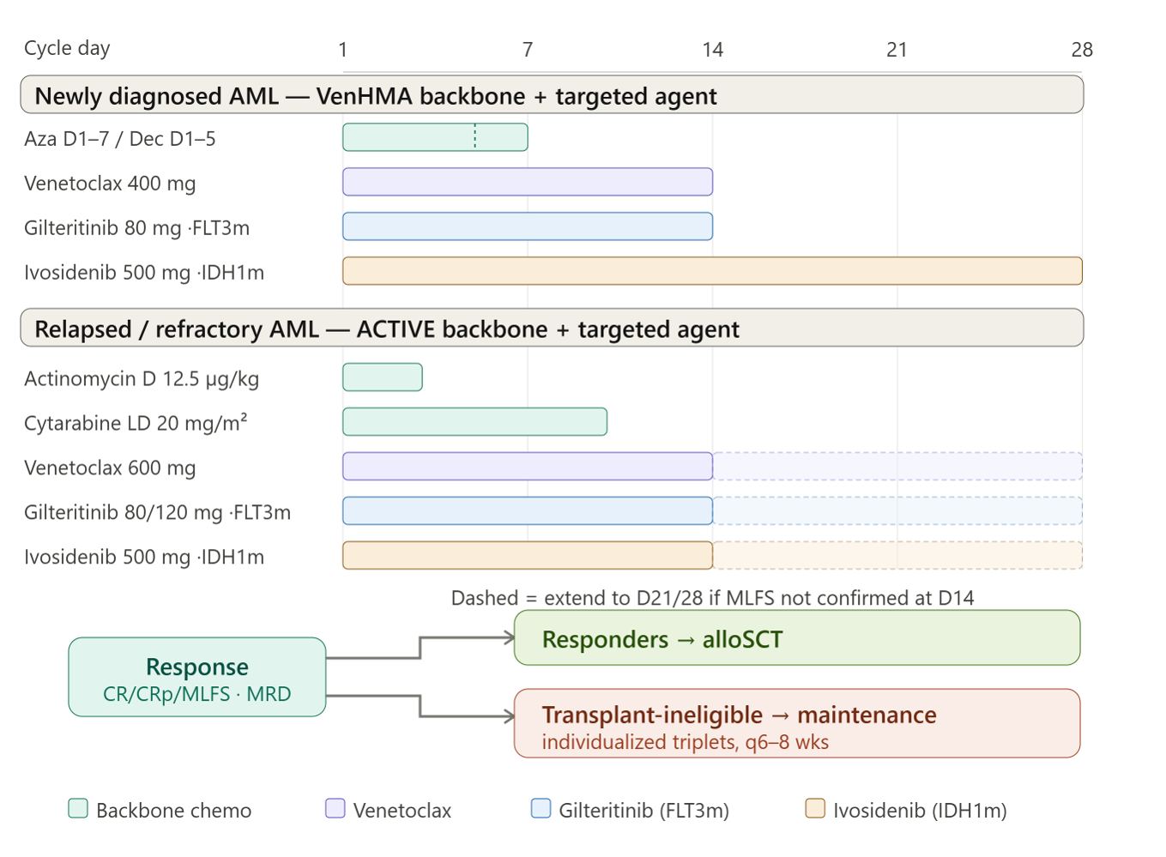
Targeted Triplet Strategies in FLT3- and IDH1-Mutated AML (2)
A retrospective, single-center study.
The patients were ≥ 18 years old, had FLT3m or IDH1m AML and received gilteritinib or ivosidenib in combination with venetoclax-based regimens.
Treatment and data collection were approved by the Vilnius University Hospital Santaros Klinikos Hematology Board and the Vilnius Regional Biomedical Research Ethics Committee.
EHA 2026, Žučenka A, abstract PF565

Slide 74
Targeted Triplet Strategies in FLT3- and IDH1-Mutated AML (3)
Characteristics | ND FLT3m AML (13) | R/R FLT3m AML (32) | ND IDH1m AML (5) | R/R IDH1m AML (3)
Age, median (range) | 79 (65-88) | 64 (34-87) | 65 (48-82) | 67 (58-75)
ECOG, median (range) | 2 (0-3) | 1 (0-3) | 1 (0-2) | 1 (0-1)
Adverse risk group (ELN 2022) | 54% | 34% | 100% | 67%
FLT3-ITD | 69% | 66% | 0 | 0
FLT3-TKD | 23% | 22% | 0 | 0
FLT3-ITD + FLT3-TKD | 8% | 12% | 0 | 0
Response evaluation
CR | 62% | 47% | 60% | 100%
CRp | 15% | 25% | 40% | 0
MLFS | 0 | 22% | 0 | 0
ORR | 77% | 94% | 100% | 100%
MRD negativity in CR/CRp patients (MFC) | 70% | 57% | 80% | 100%
FLT3 or IDH1 molecular clearance in CR/CRp patients | 50% | 52% | 40% | 67%
Consolidation with alloSCT | 8% | 47% | 40% | 33%
Consolidation with alloSCT in eligible patients at baseline | 50% | 79% | 100% | 100%
Treatment details
Number of treatment cycles, median (range) | 2 (1-22) | 2 (1-12) | 4 (1-6) | 4 (1-11)
Early all-cause mortality
Day 30 mortality | 0 | 6% | 0 | 0
Day 60 mortality | 8% | 16% | 0 | 0
EHA 2026, Žučenka A, abstract PF565

Slide 75
Targeted Triplet Strategies in FLT3- and IDH1-Mutated AML (4)
100
Overall survival in FLT3m AML
80
Median OS
The median duration of response in each subgroup:
  FLT3m AML: 13 months (not reached in ND and 8.3 months in R/R cases)
  IDH1m AML no relapses were confirmed
This real-world study demonstrates high antileukemic efficacy of venetoclax + gilteritinib/ivosidenib combination regimens for FLT3m or IDH1m AML, both in ND and R/R settings
ND 14,9 months
60
R/R 17 months
Survival probability (%)
40
20
0
70
0
10
20
30
40
50
60
Months
Overall survival in IDH1m AML
100
Conclusions
80
60
Median OS
Survival probability (%)
ND not reached
40
R/R not reached
20
0
0
2
4
6
8
10
12
14
16
18
Months
EHA 2026, Žučenka A, abstract PF565

Slide 76
Ziftomenib + Intensive Chemotherapy: Long-Term Results of the KOMET-007 Study (1)
KOMET-007 (NCT05735184) is an ongoing, multi-cohort, open-label, dose-escalation (phase 1a) and expansion (phase 1b) study of ziftomenib in combination with standard therapies in adults with newly diagnosed or R/R NPM1-m or KMT2A-r AML
99 enrolled and treated with Ziftomenib 600 mg QD / 7+3 combination
49 NPM1-m
50 KMT2A-r
Median follow-up was 17,6 months for NPM1m and 11,0 months for KMT2A-r
90% (44/49) of NPM1-m and 62 % (31/50) of KMT2A-r patients were still on-study
23 on ziftomenib treatment
10 received on-study HSCT
31 Entered ziftomenib maintenance (8 post-HSCT)
26 discontinued treatment
20 on ziftomenib treatment
32 received on-study HSCT
22 Entered ziftomenib maintenance (21 post-HSCT)
30 discontinued treatment
Baseline characteristics
N (%) | NPM1-m (n = 49) | KMT2A-r (n = 50) | All patients (n = 99)
Median age, years (range) | 60 (30-71) | 43 (18-70) | 53 (18-71)
EHA 2026, Zeidan AM, abstract S130

Slide 77
Ziftomenib + Intensive Chemotherapy: Long-Term Results of the KOMET-007 Study (2)
Safety and tolerability of Ziftomenib with 7+3
Ziftomenib safety profile in combination with intensive chemotherapy was consistent with that reported for 7+3 alone
﻿﻿No new or unexpected AEs with long-term follow-up
Grade ≥3 AEs of Interest
Differentiation syndrome (DS):
  4 Gr3 DS cases (4%; 1 NPM1-m, 3 KMT2A-r); no Gr4
  All DS events successfully resolved and continued Ziftomenib treatment
QTc prolongation:
  3 Gr3 investigator-assessed QTc prolongation cases; none ziftomenib-related); no Gr4
  All QTc events successfully resolved and continued Ziftomenib treatment
EHA 2026, Zeidan AM, abstract S130

Slide 78
Ziftomenib + Intensive Chemotherapy: Long-Term Results of the KOMET-007 Study (3)
Clinical activity of Ziftomenib with 7+3
n (%) | NPM1-m (N=49) | KMT2A-r (N=50) | All Patients (N=99)
CRc | 47 (96) | 45 (90) | 92 (93)
ORR | 48 (98) | 46 (92) | 94 (95)
CR | 46 (94) | 41 (82) | 87 (88)
Central molecular MRD negativity: Newly diagnosed NPM1-m aml
n/N (%) | Central MRD (Threshold <0.1%) | Central MRD (Threshold <0.01%)
CRc MRD negativity rate | 31/39 (79) | 22/39 (56)
Median time to MRD negativity, months (range) | 2.2 (0.7-2.6) | 2.3 (0.8-3.1)
Timing of MRD negativity By Cycle 1 By Cycle 2 By Cycle 3 | 10/31 (32) 31/31 (100) 31/31 (100) | 6/22 (27) 22/22 (100) 22/22 (100)
EHA 2026, Zeidan AM, abstract S130

Slide 79
Ziftomenib + Intensive Chemotherapy: Long-Term Results of the KOMET-007 Study (4)
Duration of treatment and clinical outcome
NPM1-m
KMT2A-r
Best overall response
CR
CRh
CRi
MLFS
PR
Treatment disposition
Ongoing
HSCT
Relapsed/refractory
Patient withdrawal
Death
AE
Other
0
4
8
12
16
20
24
Duration of treatment (months)
0
4
8
12
16
20
24
After a median follow-up of 17,6 months (range 1,0-23,5)
Median duration of CR was not reached
10 NPM1-m patients received HSCT
After a median follow-up of 11,0 months (range 0,9-21,9)
Median duration of CR was 12 months
32 KMT2A-r patients received HSCT
EHA 2026, Zeidan AM, abstract S130

Slide 80
Ziftomenib + Intensive Chemotherapy: Long-Term Results of the KOMET-007 Study (5)
Overall survival
NPM1-m
KMT2A-r
1,0
1,0
0,8
0,8
0,6
0,6
Probability of overall survival
Probability of overall survival
0,4
0,4
0,2
0,2
0
0
0
3
6
9
12
15
18
21
24
0
3
6
9
12
15
18
21
24
Patients at risk
Months
Patients at risk
Months
49
48
48
46
45
37
21
8
0
50
47
38
33
23
13
3
1
0
After a median follow-up of 17,6 months (range 1,0-23,5)
Median OS was not reached
  NPM1-m : 94% OS rate at 12 months
60-day mortality: 2% (1/49)
After a median follow-up of 11,0 months (range 0,9-21,9)
Median OS was not reached
  KMT2A-r : 71% OS rate at 12 months
60-day mortality: 4% (2/50)
EHA 2026, Zeidan AM, abstract S130

Slide 81
Ziftomenib + Intensive Chemotherapy: Long-Term Results of the KOMET-007 Study (6)
In KOMET-007, Ziftomenib 600 mg QD combined with 7+3 was well tolerated with a safety profile consistent with previous reports
Robust clinical activity with deep and durable responses in newly diagnosed NPM1-m and KMT2A-r AML
These data support the ongoing Phase 3 registrational trial of Ziftomenib in combination with intensive chemotherapy in newly diagnosed AML (KOMET-017; NCT07007312)
EHA 2026, Zeidan AM, abstract S130

Slide 82
Ziftomenib Exposure–Response Analysis in NPM1m/KMT2Ar AML (1)
Population PK analysis: 450 subjects (14 healthy volunteers, 436 AML patients) from KOMET-001 and KOMET-007 used to characterize ziftomenib exposure.
Exposure–response analysis: ~260 AML patients from KOMET-007 treated with ziftomenib + Ven/Aza or 7+3.
Objective: Assess relationship between ziftomenib exposure and efficacy (ORR/CR), differentiation syndrome, and AEs to support dose selection.
Exposure-Response Correlation
Differentiation Syndrome Correlation
1,0
1,0
0,75
0,75
Probability of MLFS
CRp, CRi, CRh, CR or CR_{MRD}
Probability of TE differentitation
syndrome
0,50
0,50
0,25
0,25
0
0
600
600
400
400
Treatment (mg)
Treatment (mg)
200
200
0
5000
10000
15000
20000
25000
30000
0
5000
10000
15000
20000
0
5000
10000
15000
20000
25000
30000
NPM1
KMT2A
NPM1
EHA 2026, Mitra A, abstract PF537
Notes:
No correlation between steady state Zifto AUC and ORR or DS

Slide 83
Ziftomenib Exposure–Response Analysis in NPM1m/KMT2Ar AML (2)
Question | Answer
Does higher ziftomenib exposure improve ORR with Ven/Aza? | No (NPM1-m p=0.935; KMT2A-r p=0.695)
Does higher ziftomenib exposure improve ORR with 7+3? | No (KMT2A-r p=0.924; ORR >90% across exposure range in NPM1-m)
Does higher ziftomenib exposure increase differentiation syndrome? | No (all analyses non-significant)
Do patient or treatment factors meaningfully affect ziftomenib exposure? | Yes, clinically meaningful covariates identified (including Health status, Food, PPIs, and CYP3A inhibitors)
What this supports
Fixed-dose ziftomenib
No therapeutic drug monitoring
No exposure-based dose titration
Continued use of 600 mg QD in registration studies and clinical practice
EHA 2026, Mitra A, abstract PF537

Slide 84
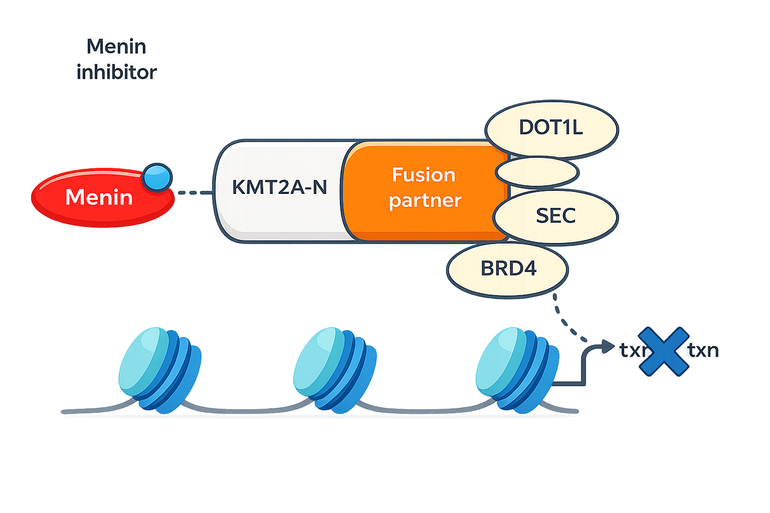
Acquired MEN1 Resistance Mutations Identified During Menin Inhibition in a Phase 1 Enzomenib Trial (1)
Menin inhibitors demonstrated promising efficacy in
relapsed/refractory KMT2Ar and NPM1m leukaemia
 | KMIZAr |  | NPM1m
 | No of patients | Response rate* | No of patients | Response rate*
Revumenib | 57 | 44% (22.8% CR/Ch) | 64 | 29.7% (23% CR/CRh)
Ziftomenib | - | - | 92 | 26% (22% CR/CRh]
Bleximenib | Response rate 40%
Enzomenib | 61 | 40% | 34 | 44%
Leukemia
Issa, JCO 2024, Arellano, Blood 2025
Wang, JCO 2025, Searle, ASH 2024
Daver, ASH 2025
*CR, CRi, CRh, CRp only
EHA 2026, Allred C, abstract PS1527

Slide 85
Acquired MEN1 Resistance Mutations Identified During Menin Inhibition in a Phase 1 Enzomenib Trial (2)
Study Objective
Characterize acquired MEN1 resistance mutations in patients who relapsed after Enzomenib monotherapy
Compare observed resistance mutations with preclinical predictions
Methods
17 patients treated with Enzomenib monotherapy in the Phase 1 of DSP-5336-101
13 patients had serial molecular profiling performed at baseline and relapse
Highly sensitive ddPCR assay (LoD 0.01%) used to detect MEN1 mutations
EHA 2026, Allred C, abstract PS1527

Slide 86
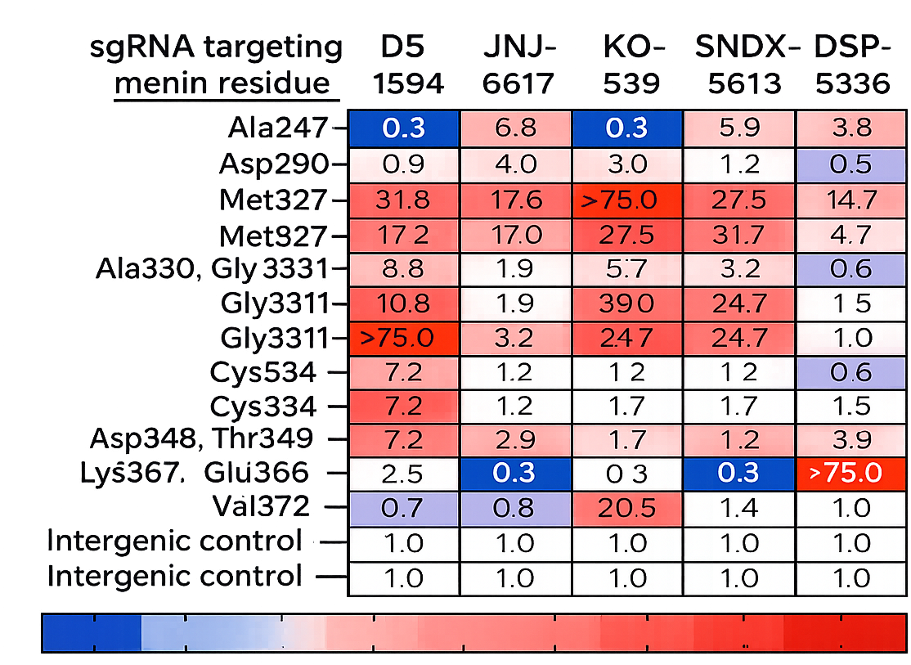
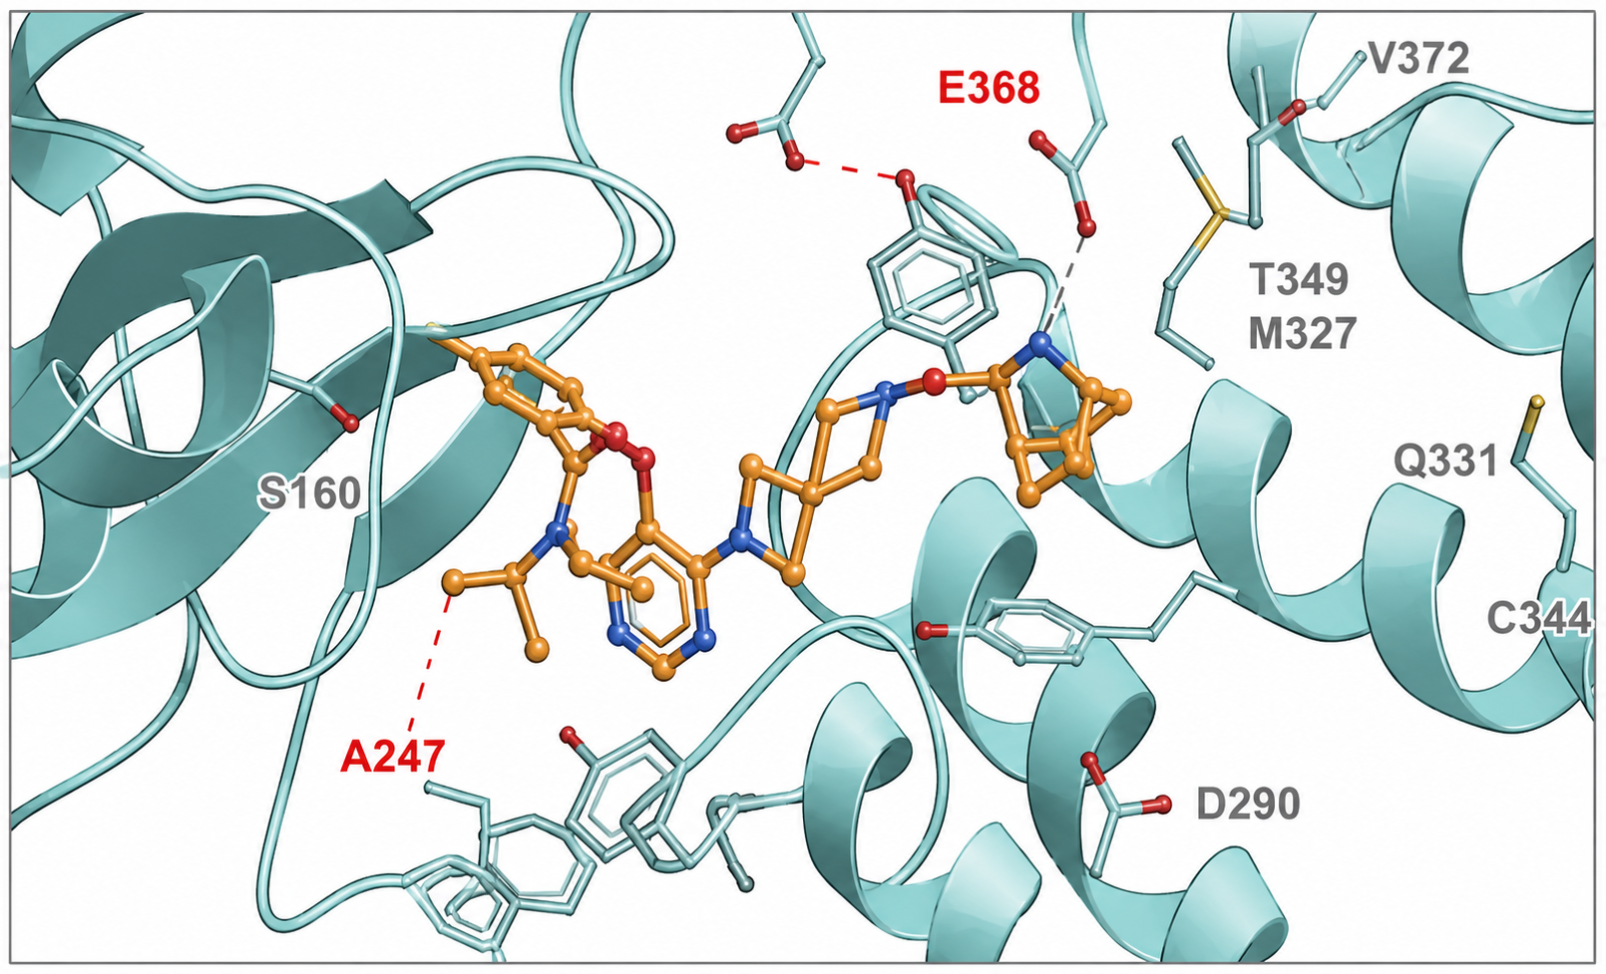
Acquired MEN1 Resistance Mutations Identified During Menin Inhibition in a Phase 1 Enzomenib Trial (3)
Preclinical Prediction of Resistance to Menin inhbition
MV4;11 MEN1 base editor system IC50 shift prediction
E368 predicted to form hydrogen bond with enzomenib
Glu368
EHA 2026, Allred C, abstract PS1527

Slide 87
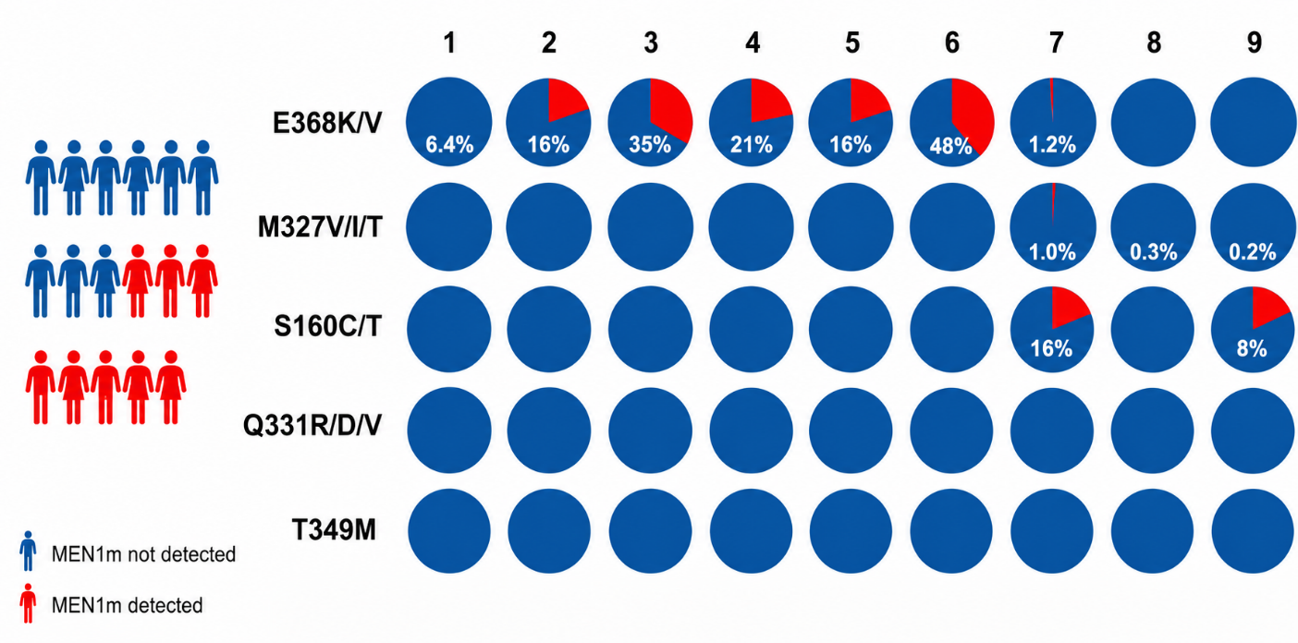
Acquired MEN1 Resistance Mutations Identified During Menin Inhibition in a Phase 1 Enzomenib Trial (4)
Phase 1 of DSP-5336-101
Results
Phase 1 - Dose Escalation
Phase 1 - Dose Optimization
Phase 2 - Registrational
300 mg BID
R/R KMT2Ar AL
R/R Acute Leukemia
w/ KMT2Ar or NPM1m
40-400 mg BID
Dose Optimization
200 mg BID
300 mg BID
400 mg BID
RP2D
R/R NPM1m AML
R/R AML
w/NPM1m
Patients who responded and subsequently relapsed were profiled for MEN1m
9/17 patients with MEN1m after Enzomenib
E368K is the dominant MEN1m
All patients with MEN1m E368K experienced dose interruptions (5/7) or suboptimal dosing (2/7)
EHA 2026, Allred C, abstract PS1527

Slide 88
Acquired MEN1 Resistance Mutations Identified During Menin Inhibition in a Phase 1 Enzomenib Trial (5)
Conclusions
Question | Answer
Do MEN1 resistance mutations emerge after enzomenib? | Yes – detected in 9/17 patients (53%) at relapse
What was the dominant resistance mutation? | E368K
Were other MEN1 mutations observed? | Yes, but infrequently (M327T 1.9%, S160C 16%)
Are resistance patterns consistent with preclinical predictions? | Yes – E368K was predicted to preferentially reduce enzomenib activity
Do treatment interruptions matter? | Data suggest dose interruptions/suboptimal exposure may facilitate emergence of resistant clones
EHA 2026, Allred C, abstract PS1527

